Slide 1

Integrating Early Childhood Development Interventions into HIV Clinical Care Interventions

Slide 2
Webinar agenda
Overview
Early childhood vulnerability and HIV
Why introduce ECD into clinical care?
Strategies and Opportunities for Integration
Mothers2mothers
Partners in Health, Rwanda
Questions and Discussion

Slide 3
Early childhood vulnerability and HIV
Millions of children under 5 in LMIC fail to reach physical, cognitive, linguistic and social-emotional potential
Implications on educational attainment, physical/mental health, social citizenry, economic participation
Linked to poverty, nutritional deficit, inadequate learning opportunities
24% of pregnant women with HIV still did not have access to ART
Only 54% of children exposed to HIV were tested within 2 months (21 highest HIV burden countries)
Infants with HIV are 75% less likely of dying from related illness if given ART within the first 12 weeks
Infants living with HIV & those HIV-exposed significant mental and motor delays during the first two years of life
Neurological and developmental delays are often markers of HIV infection in infants
EARLY CHILDHOOOD – A CRITICAL PERIOD FOR DEVELOPMENT!
Notes:
Black, M., Walker, S., Fernald, L., Andersen, C., et al. (2017). Early childhood development coming of age: science through the life-course. Lancet, 389: 77-90.
UNAIDS. (2017). Ending AIDS: progress towards the 90-90-90 targets. Retrieved from http://www.unaids.org/sites/default/files/media_asset/Global_AIDS_update_2017_en.pdf.
Potterton, J. (2008). A longitudinal study of neurodevelopmental delay in HIV infected children. Retrieved from http://wiredspace.wits.ac.za/handle/10539/5055.
Blanchette, N., Lou, M., & Fernandes-Penney, A. (2001). Cognitive and motor development in children with vertically transmitted HIV infection. Brain and Cognition. Retrieved from http://www.sciencedirect.com/science/article/pii/S0278262601800324.
Bisiacchi, P., Suppiej, A., & Laverda, A. (1999). Neuropsychological evaluation of neurologically asymptomatic HIV-infected children. Brain and Cognition. Retrieved from http://europepmc.org/abstract/med/10857661.
Van Rie, A., Harrington, P.R., Dow, A., Robertson, K. (2007). Neurologic and neurodevelopmental manifestations of pediatric HIV/AIDS: a global perspective. European Journal Pediatric Neurology; 11: 1–9.
Le Doare, K., Bland, R., & Newell, M. (2012). Neurodevelopment in Children Born to HIV-Infected Mothers by Infection and Treatment Status. Pediatrics, doi:10.1542/peds.2012-0405.
Sherr, L. and Roberts, K. (2017). Child development testing review: A comprehensie reader to inform field utilization. Produced for USAID.

Slide 4
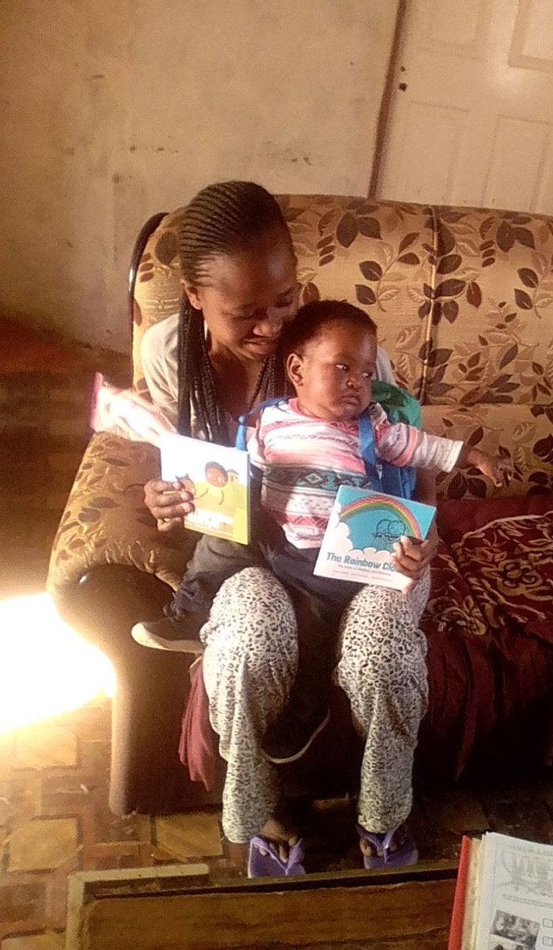
Why introduce ECD
into clinical care?
Professor Lucie Cluver
Oxford University

Slide 5
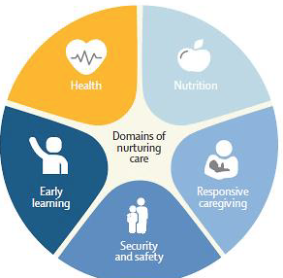
WHO Nurturing Care Framework (2018)

Slide 6
Bringing it all together
(physical, cognitive & socioemotional capacities to learn, earn, innovate, and contribute)
PROMOTE EQUITY
NURTURING CARE
Adequate nutrition and health care (preventive and curative)
Responsive care and early learning opportunities
Safety and security (protection from stress, violence, infections, toxins)
Good nutritional status of women
Essential newborn care
Exclusive & continued breastfeeding
Appropriate complementary feeding & young child nutrition with micronutrients as required
Immunization
Treatment of childhood illnesses
Positive and engaging interactions with parents/caregivers
Language-based interactions
Opportunities for age-appropriate and play and exploration
Positive emotional connections
Good hygiene practices
Household safety and sanitation
Daily routines and security (sleep, feeding)
Supportive discipline
Avoid/mitigate neglect, violence, displacement, household shocks, conflict
ENABLING ENVIRONMENT
Caregiver physical & mental health
Household income & food security
Caregiver empowerment
Quality health care
Affordable & quality childcare
Safe & supportive neighborhoods

Slide 7
Why not?
Divisions between healthcare system and social welfare/education systems
Practitioner level
Funding level (government services, NGOs)
National level
Time shortages of healthcare staff
Limited capacity for referral networks
Lack of understanding of evidence-base

Slide 8
RCTs: Compelling evidence on ECD and HIV care
Cluster RCT Malawi: women’s support groups (Lewycka et al 2013)
lower perinatal mortality (OR.67)
Lower neonatal mortality (OR.59)
Lower infant mortality (OR.72)
Lower maternal mortality (OR.26)
Multicentre cohort South Africa: psychosocial support (Grimwood et al 2012)
Lower pediatric mortality (HR .39)
Higher viral suppression (OR 1.6)
Increased ART retention (HR .57)

Slide 9
RCTs: Compelling evidence on ECD and HIV care
RCTs South Africa: maternal peer mentoring within PMTCT
(Richter et al 2014, Tomlinson et al 2014)
Increased height-for-weight z-scores for HIV+ and HEU infants
Adherence to infant ART (OR 1.7) and maternal ART
Increased exclusive breastfeeding (RR 1.92)
RCT South Africa: integrated Maternal and Child Healthcare and ART Care
(Myer, Phillips, Zerbe, Brittain, Le Roux, Remien, Mellins, McIntyre, Abrams 2018)
Increased maternal retention in care and suppressed VL (ARD 21%)
Longer breastfeeding (exclusive and any)

Slide 10









The Child Health Intervention for Development Outcomes (CHIDO) Trial

Slide 11

Evaluating Integration of Early Childhood Development Interventions into the m2m Program in Swaziland

Slide 12
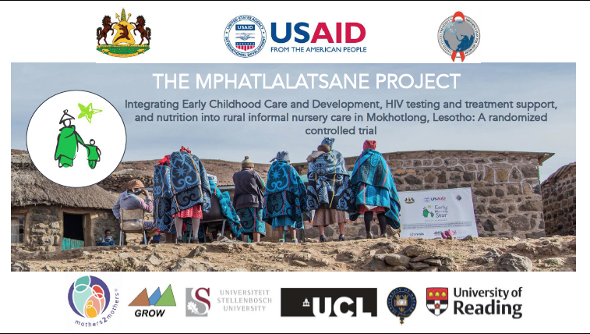

Slide 13
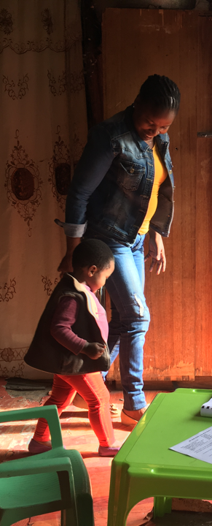
ECD and clinical care
go together like
paper and crayons!

Slide 14
Webinar: Integrating ECD into HIV Clinical Care Interventions
Fiona Burtt
Senior Technical Advisor – ECD/OVC
12 July 2018

Slide 15
WHERE m2m WORKS - ECD
Malawi:
Integrated ECD/RMNCH (AN + 0-3 yrs)
Eswatini:
ECD + PMTCT
(AN + 0-2 yrs)
South Africa:
ECHS
(0-5 yrs)
Lesotho:
ECD + PMTCT
(0-5 yrs)

Slide 16
IDENTIFYING AND ENROLLING ECD CLIENTS
FACILITY ENROLMENT
AN/PN index clients
AN/PN
vulnerability screening +
community enrolment
HOUSEHOLD ENROLMENT
Other potential
clients in HH
of index client
COMMUNITY ENROLMENT
Community mapping,
neighbours of
index clients
HIGH RISK
Facility-based care
+ HH intervention
+ monthly AN or PN
parenting groups
LOW RISK
Facility-based care
+ monthly AN or PN
parenting groups

Slide 17
ASSESSING VULNERABILITY
Poor maternal mental health
HIV-exposed infant
(HIV+ mother)
HIV-positive
0-3
0-3 with other HIV-positive caregiver
0-3 poor nutrition status
Mother = sex worker
0-3 stunting
Living in very rural area (least serviced)
HIGH RISK
(ECD/
RMNCH)
CLIENTS
Premature/ LBW baby
Types of vulnerability
GBV
0-3 with disability +/ or chronic illness
Elderly or disabled caregiver
Orphan (esp no female parent) +/or abandoned child
Economically vulnerable HH
Least educated
parent/ caregiver
Alcohol/ substance abuse
Child-headed HH
Very young mother
POVERTY

Slide 18
m2m’s FAMILY-CENTRED APPROACH

Slide 20





A model to improve nutritional and developmental outcomes for medically vulnerable under 5 children in rural Rwanda
12 July 2018 | Integrating ECD in Clinical Care Webinar
Pediatric Development Clinic

Slide 21

Why ECD in the health sector?
The first years of life are a critical period for growth and development of under 5 children
Early interventions can improve the nutritional, health, cognitive, motor and social- emotional development which impact long-term outcomes including educational attainment and productivity later in life
Neonatal survival is increasing in Rwanda due to efforts to improve maternal and neonatal care, but no system of routine follow-up for high-risk infants exists.
  Infants managed in hospital neonatal units remain at high risk of health, nutritional, and developmental impairments

Slide 22
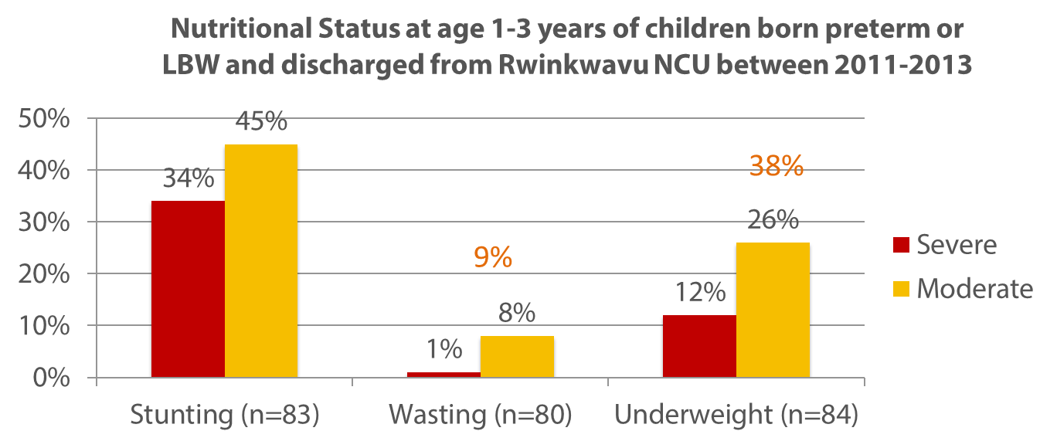
Assessment of preterm/low birth weight outcomes in the absence of structured follow-up
67% had an abnormal development screening on the ASQ-3
79%
Kirk et al. (2017). Health, nutrition and development of children born preterm and low birth weight in rural Rwanda: a cross-sectional study. BMC Pediatrics.
Notes:
Of 158 eligible preterm and LBW children discharged from RDH NU, 86 (54%) were alive and located for follow-up data collection and 9 (6%) were confirmed to have died after discharge. Median birth weight was 1,650 grams, median gestational age was 33.1 weeks, and 57% were growth restricted at birth. At the time of household interviews, median age was 22.5 months, 47% of children had feeding difficulties and 40% reported signs of anemia.

Slide 23
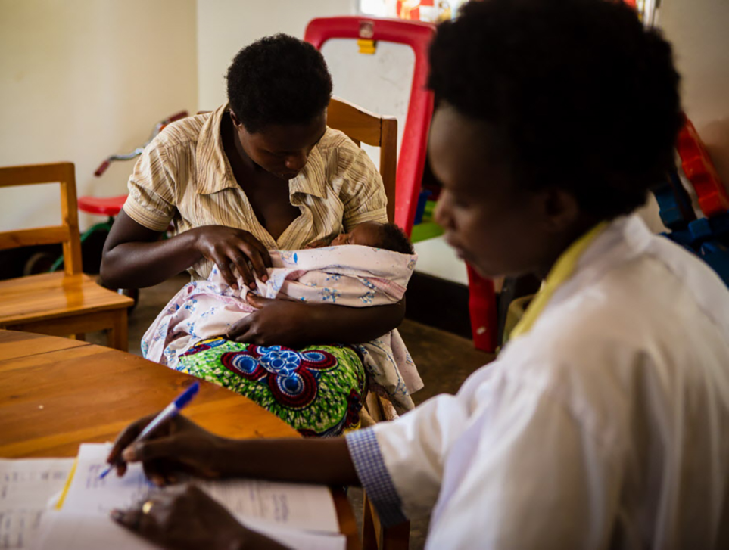
What is the Pediatric Development Clinic?

Slide 24
Pediatric Development Clinic:
Supporting Early Childhood Development for At-Risk Infants
Medical: Monitoring and Care
Nutrition: Growth Monitoring and Care
Responsive Care: Play and Communication
Integrated Social Support
Notes:
PDC provides medical, nutritional and developmental follow-up to at-risk children under-five
Early intervention embedded in a medical home model
Prematurity main referral reason.

Slide 25
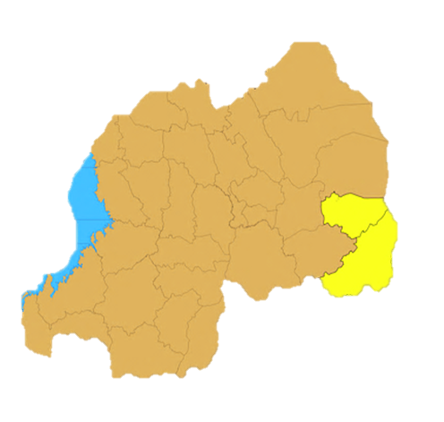


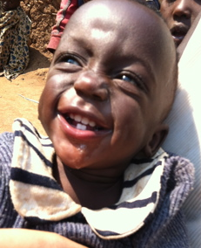
Populations Served
Primary:
  Infants with prematurity or low birth weight
  Birth asphyxia/CNS infection
Secondary:
  Following severe malnutrition (requiring hospitalization) in infants <12 months
  Trisomy 21 and suspected genetic syndrome
  Cleft lip/palate
  Hydrocephalus
  Post cerebral malaria
  Other mild developmental delay
Over 1,500 children enrolled since April 2014
Ngabireyimana et al. (2017). A retrospective review of the Pediatric Development Clinic implementation: a model to improve medical, nutritional and developmental outcomes of at-risk under- five children in rural Rwanda. Maternal Health, Neonatology and Perinatology.

Slide 26
Pediatric Development Clinic
Visit Flow
Additional Social Support Determination:
Transport
Nutritional support
Home visits
Health, Nutrition, and Development topics, with opportunity for play and communication practice
1. Medical Monitoring and Care
2. Growth Monitoring and Care
3. Development Monitoring and Responsive Care
Group Counseling
Nurse Consultation
Social Worker Consultation

Slide 27
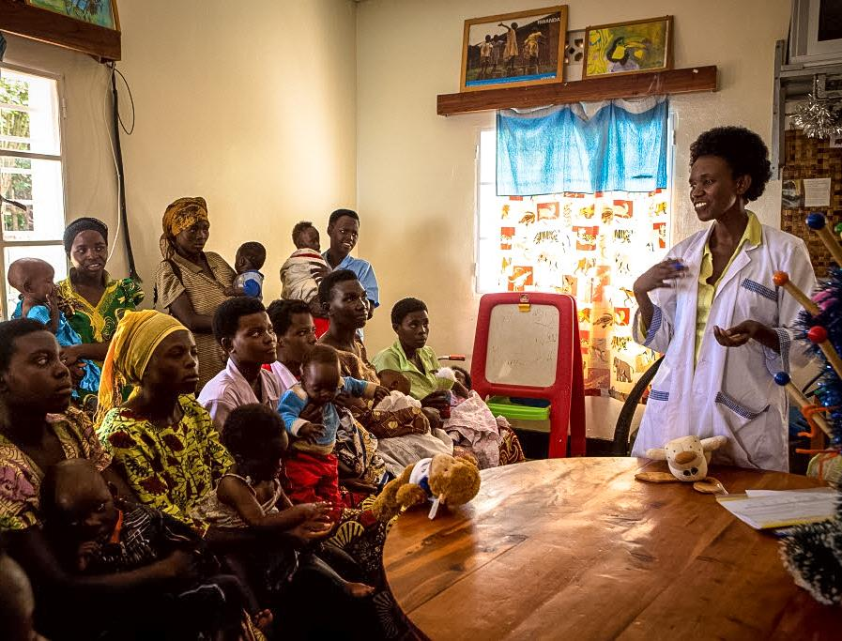
Outcomes

Slide 28
Value of PDC to Caregivers:
Mother’s Experience
Reducing Stigma
“This clinic is very important because we meet with other moms who have the same problems. I can discuss everything with other moms. I see I am not alone. Before, I would sit alone by myself because I felt shame. Now I see I am not alone in my child having a problem. I do not feel ashamed.”
Responsive Care and Early Learning
“I was taught how to interact with my child. Before I thought my child couldn’t learn anything, but now after visiting PDC clinic […] Now I sit with my child to teach him. This is a big difference. Before coming here I did not know I should do this. Now I see that he can still learn.”

Slide 29
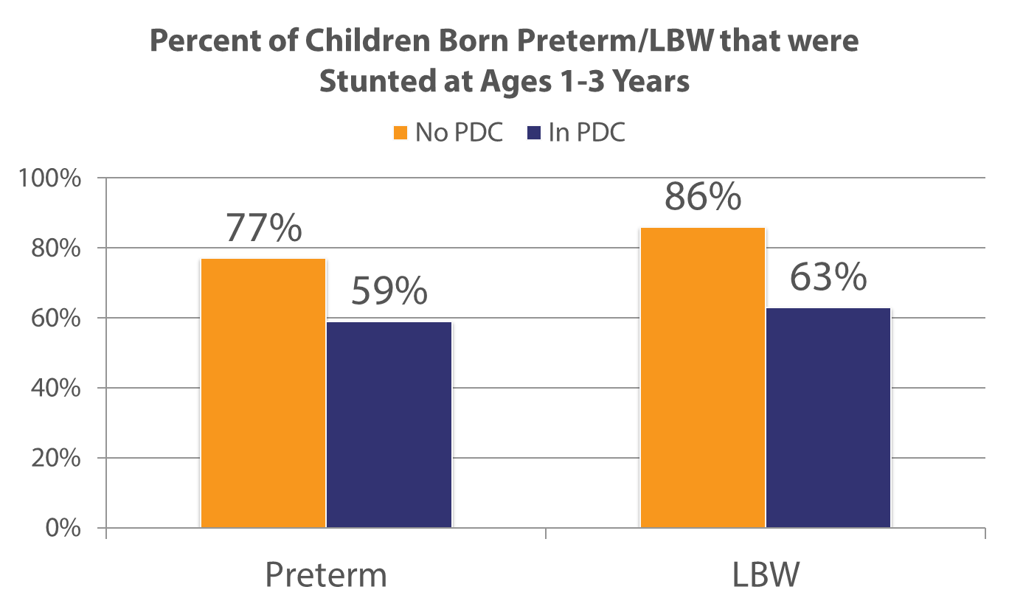
Lower Rates of Stunting at 1-3 Years

Slide 30
Challenges
Impact:
Poor Growth and Developmental Outcomes
Gaps in Parenting Education and Engagement:
Many fathers not really engaged in PDC (child health = mother’s duty)
Clinical Staff less comfortable with Developmental Care
Lack of clear tools and interventions for children with pervasive developmental delays
Gaps in Knowledge and Practice:
Incorrect Calculation of Adjusted Age
Incorrect Calculation of Interval Growth
Errors in Plotting Z-scores
Expertise in counseling on feeding in infants with difficulties
Gaps in Home Feeding:
Feeding a less responsive infant
Feeding in an infant with neurodevelopmental difficulties
Need for additional calories for catch up growth

Slide 31
Conclusions and Recommendations
Delivering follow-up care to at-risk infants is feasible through the PDC model in Rwanda using task shifting
Referral systems to higher level of care need improvement (physiotherapy, speech therapy, other specialized services)
Some components of care for these children are complex and efforts for continuous quality improvement are ongoing
Components of ECD require reinforcement, as they are less familiar to health facility staff running the PDCs

Slide 32
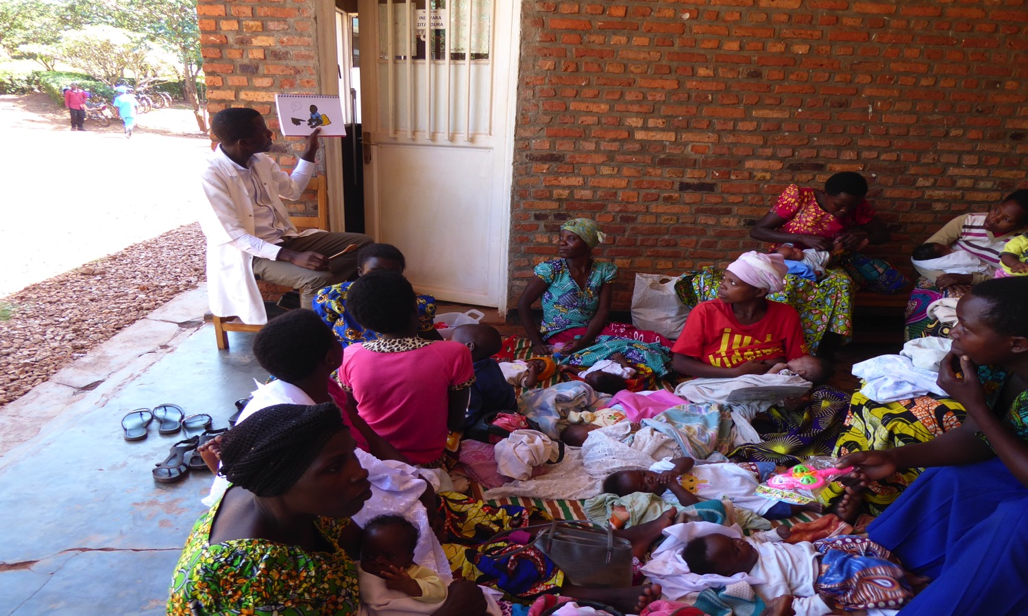
Thank You!

Slide 33

New ECD Resource
CRS have developed a sustainable model and process for integrating Early Childhood Development into maternal, child health and nutrition interventions.
CRS has a new webpage that showcases the model with up-to-date information from theory to practice through publications, podcast, videos and stories.
https://www.crs.org/our-work-overseas/program-areas/health/early-childhood-development

Slide 34
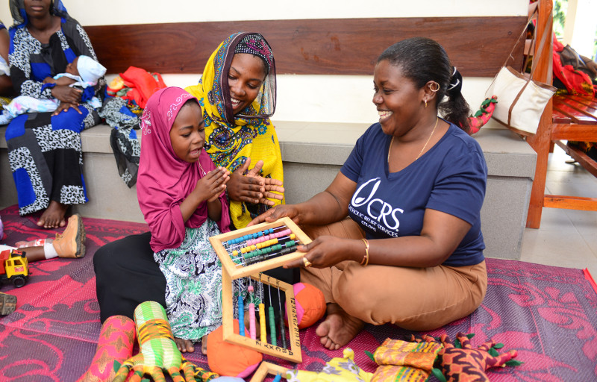
Thank you!

