Slide 1

Strengthening the Social Service Workforce for Vulnerable Children: Highlights from the 4Children Journey in Uganda
Webinar: September 16, 2020

Slide 2
Webinar Program
Welcome Remarks from Tom Fenn, Chief of Party 4Children (CRS) Remarks from Julie Grier-Villatte, EYCD Office Director, USAID Uganda Mission Director (USAID) Presentation from Michelle Ell, 4Children Uganda Project Director (CRS) Presentation from Dr. Eddy Walakira, Makerere University, Department of Social Work and Social Administration Remarks from Michael Byamukama, President of the National Association for Social Workers of Uganda (NASWU) Remarks from Birgithe Lund-Henriksen, UNICEF Chief of Child Protection, Q&A Closing Remarks

Slide 3
Julie Grier-Villatte, EYCD Office Director, USAID Uganda

Slide 4
Michelle Ell Uganda Project Director, CRS Contributions from: Barbra Aber, 4Children Technical Advisor Justus Atwijukire, 4Children Data & Evidence Building Advisor Dr. Eddy Walakira Uganda Project Director, MAKU

Slide 5
Recognizing 4Children Uganda’s Team & Partners
Agnes Kyamulabi, Research Fellow, Makerere University  Alex Collins, Technical Program Manager, Intrahealth International  Aloysious Nyombi, Research Fellow, Makerere University  Andrew Luyombo, National Coordinator, National Association of Social Workers in Uganda  Barbra Aber, Technical Advisor, Catholic Relief Services  Brenda Kyomugusha, Project Officer, Catholic Relief Services  Dan Oliver, Data & Evidence Building Director, Catholic Relief Services  David Potenziani, Senior Informatics Advisor, IntraHealth International  Doreen Alaro, Deputy Project Director, IntraHealth  Dr. Eddy J. Walakira, Associate Professor, Makerere University  Dr. Janestic Twikirize, Senior Lecturer, Makerere University  Edwin Atuhaire, System Analyst, Data Care  Eileen Ihrig, Senior Technical Advisor, Catholic Relief Services  Francesca Stuer, Senior Associate, Maestral International  Henry Owora, Project Manager, Data Care  Isabel de Bruin Cardoso, Maestral International Johnmary Ssekate, Capacity Building Officer, National Association of Social Workers in Uganda Justus Atwijukire, Data & Evidence Building Manager, Catholic Relief Services  Karen Doll, Senior Technical Advisor, IntraHealth  Kelly Bunkers, Senior Associate, Maestral International  Lindsey Lange, Technical Advisor, Catholic Relief Services  MaryJane Biira, Project Officer, Catholic Relief Services  Michael Byamukama, President, National Association of Social Workers in Uganda  Moritz Magall, Project Manager- Case Management, Catholic Relief Services  Orhan Morina, Deputy Chief of Party, Catholic Relief Services  Patrick Kagenda, MIS Specialist, Data Care  Robinson Adriko, Programme Assistant, National Association of Social Workers in Uganda  Samalie Kakai, Project Officer, Catholic Relief Services  Sian Long, Senior Associate, Maestral International  Simeo Sebukulu, Public Relations Officer, National Association of Social Workers in Uganda  Solomy Namono, Accountant, National Association of Social Workers in Uganda  Tom Fenn, Chief of Party, Catholic Relief Services  Tom Ventimiglia, Deputy Chief of Party, PACT  Wycliff Odong, Senior Project Officer, Catholic Relief Services

Slide 6
Highlights from 4Children’s Journey in Uganda:
Strengthening the social service workforce (SSW) to meet the needs of children affected by HIV and other adversities.
What were some of the key milestones?
Was there anything unique about the process/approach?
What did we learn from the data/implementation?
How might we leverage these lessons/gains across the sector?

Slide 7
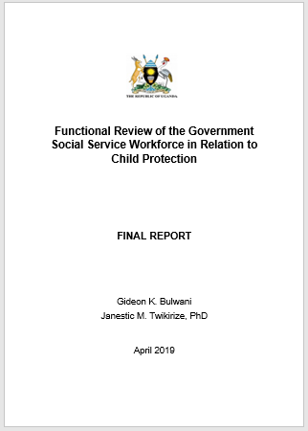
  Led by GoU with support from 4Children and UNICEF:
  Skills inventory of the workforce
  Performance-based management standards & processes
  Capacity strengthening needs and strategies
  Communication & coordination
  Organizational development challenges
Key Challenges Affecting Performance:
  Gaps in the required competencies
  Poor working environment
  Lack of basic tools and equipment
  Lack of formal induction processes
  Limited supportive supervision
  Inadequate funding
  Inadequate staffing
National Steering Committee: Ministry of Gender, Labour and Social Development Ministry of Internal Affairs Ministry of Local Government Ministry of Public Service UNICEF

Slide 8
Key Milestones in the Journey
Strengthening the SSW to meet the needs of children affected by HIV & other adversities.
GOAL
Data use to improve the response
Standardization of social work training
Harmonized case management approach
and package
Nationwide
dissemination of child protection policies

Slide 9
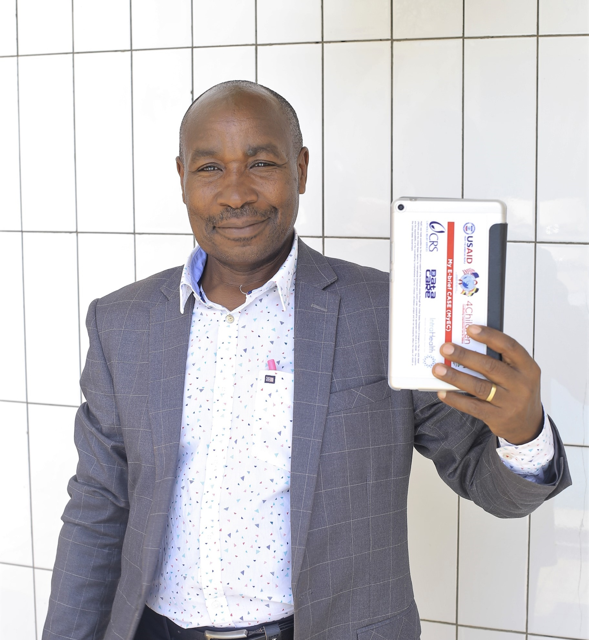
Nationwide Policy Dissemination
4C Contribution to Strengthening the SSW:
Equip the SSW with the policies, and strategies they need to carry out their protection mandate.
Over 50,000 copies of key child protection policies & guidelines disseminated to the SSW.
Electronic policy dissemination by supporting GoU to develop, launch, and roll-out the SSW App.

Slide 10
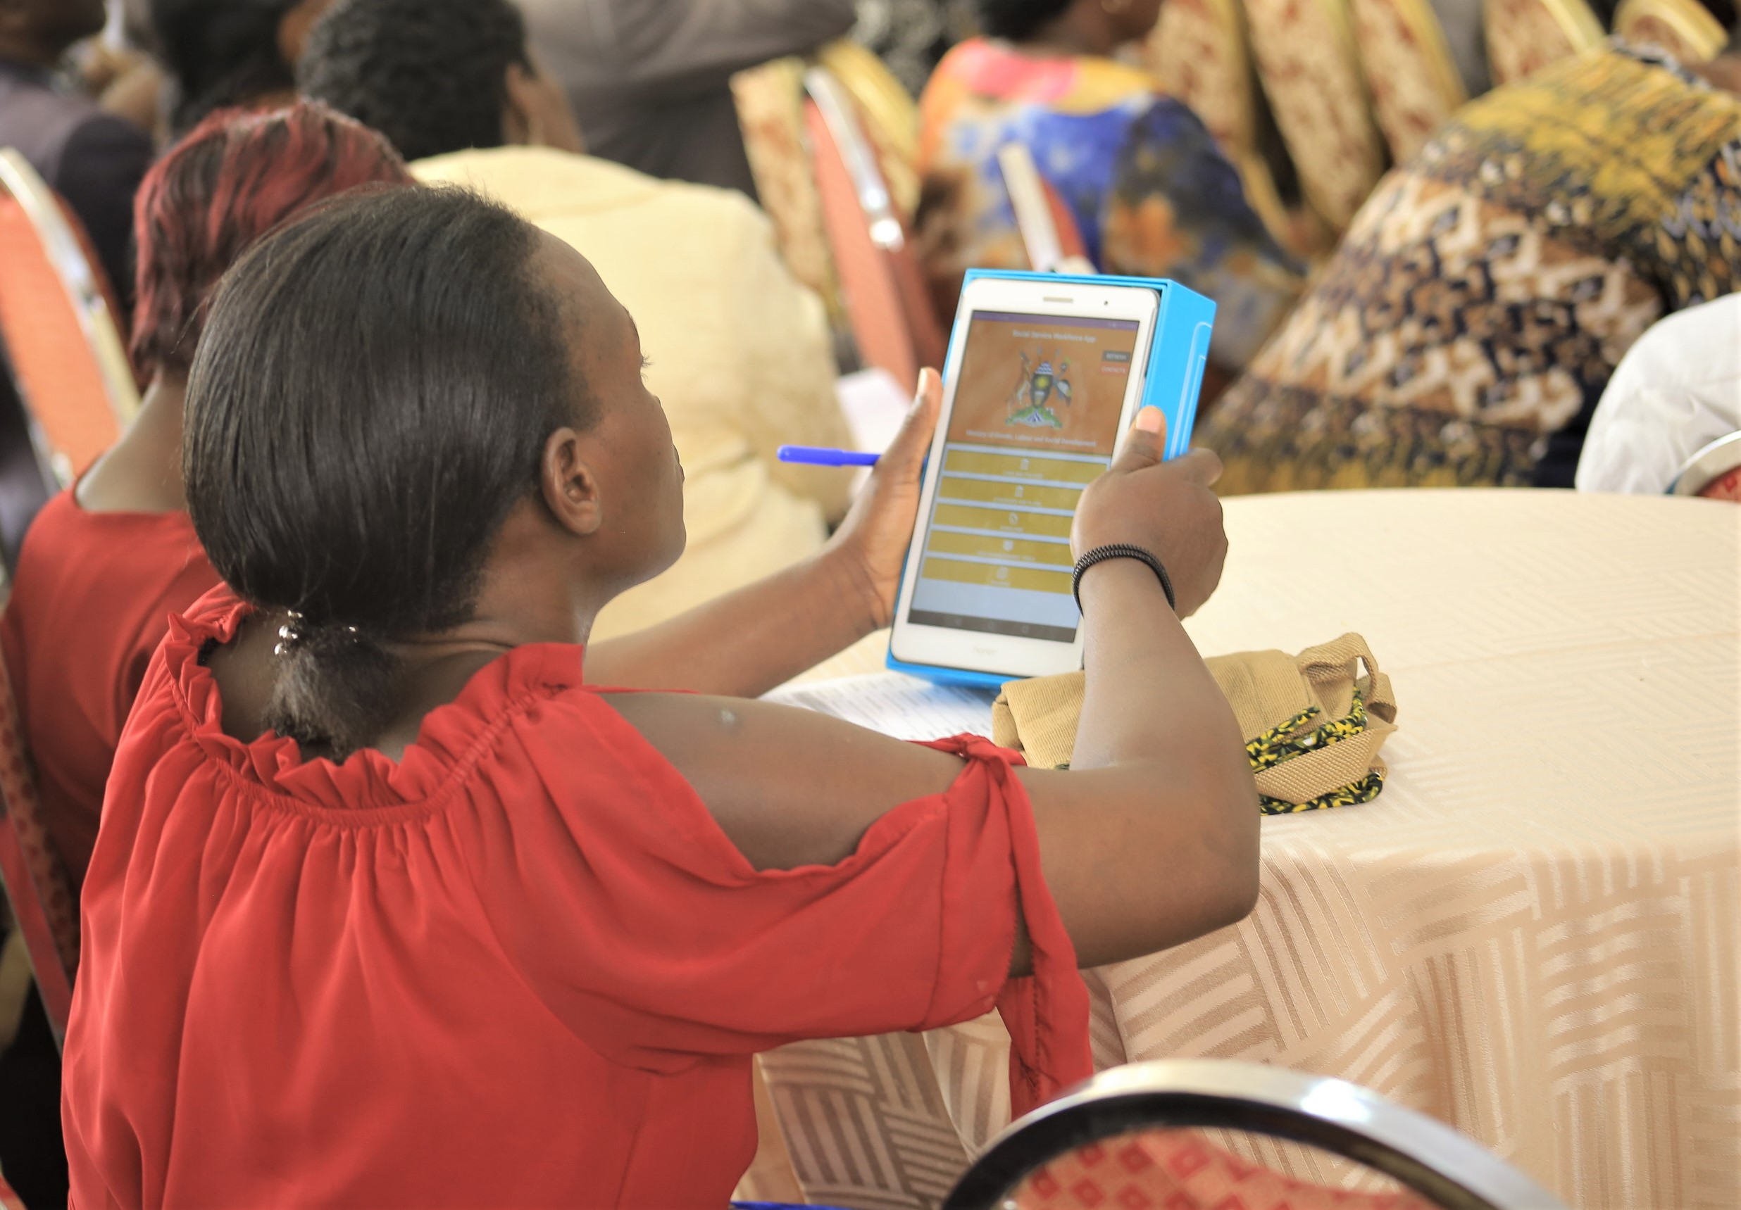
Social Service Workforce App
Provide electronic copies of key policies, strategies, training materials (121)
Explain key policy provisions with audio podcasts (17)
Support e-learning: case management
Facilitate communication
(500+ contacts)
Links to OVC MIS
Notes:
Policies & Legal Frameworks
National Strategies & Plans
Guidelines for Implementation
Audio Podcasts
Case Management Tools
Link to Reporting
Contacts for public servants, police, courts
Child Protection Dashboards

Slide 11
App Usage and Utility
93% (n=174) of users surveyed report using the SSW App daily or weekly.
16,868 documents accessed (policies, national strategies, curricula)
26,089 contact searches
1,504 podcast listens

Slide 12
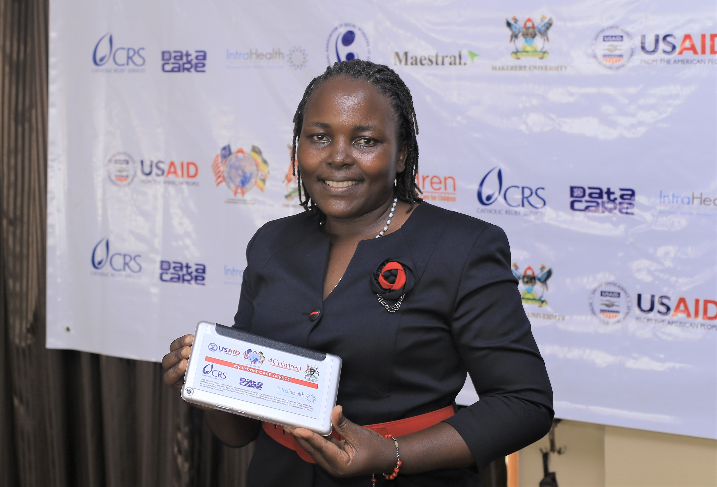
Quotes from Workforce about the App:
“During the court session involving a juvenile, the Magistrate was still using the old Children’s Act, which I challenged. I referred to my tablet with the information on the Amended Children’s Act, the case was resolved.”
“When I want to refer a survivor to another district, I use the App to find the contact and also for follow up to find out whether the survivor reached [the service point]”
“In one meeting, we were discussing some policy issues and I accessed my tablet for the information. I looked more relevant in the meeting since I had all the information I needed.”

Slide 13
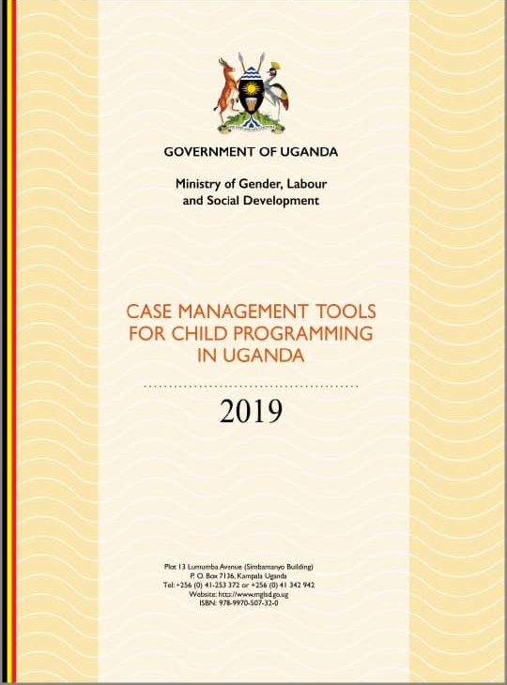

Harmonized Case Management Approach & Package
4C Contribution to Strengthening the SSW:
Support collaboration between government and civil society to deliver family-focused, child-sensitive case management.
Over 30 agencies engaged in process:
Desk Review & Tools Assessment
Workforce Consultations
Technical Working Group Meetings
Tools Review/Standardization
Pretest
Final Review & Validation
Ministry of Local Government
National Association of Social Workers of Uganda (NASWU)
Association of Volunteers in International Service (AVSI) Foundation
Catholic Relief Services
Child Helpline
Probation and Social Welfare Officers (PSWOs)
Community Development Officers (CDOs)
Parasocial Workers (PSWs)
Baylor College of Medicine Children’s Foundation (Baylor Uganda)
Children’s AIDS Fund (CAF)
Children at Risk Action Network
Infectious Diseases Institute (IDI)
IntraHealth
Kalangala Comprehensive Health Services Project
Maestral International
Makerere University School of Public Health (MUSPH)
MEASURE Evaluation
Mildmay
Makerere University Joint AIDS Program (MJAP)
Makerere University Walter Reed Project (MUWRP)
Makerere (SWASA)
Reach Out Mbuya
Retrak
Rakai Health Sciences Program
Save the Children in Uganda
Strategic Information Technical Support (SITES)
The AIDS Support Organization (TASO)
Uganda Catholic Medical Bureau (UCMB)
Uganda Private Health Support Program (UPHS)
United Nation Children’s Fund (UNICEF)
United Nations High Commissioner for Refugees (UNHCR)
World Education/Bantwana
World Vision

Slide 14
Coordinated Roll-out of the New Guidance
TOT package developed
Trained 65 core trainers (GoU & CSO)
Development of E-learning modules;
587 enrolled, and 373 completed
Printed 3,200 copies; electronic distribution: SSW App
and 1500 USBs
Updated and printed 1,800 copies of the PSW Training Manual and PSWO Handbook
USAID/SITES digitized the CM Tools and supported regional trainings for 379 district and Implementing Partner staff from 73 districts.
Within 6 months of validation, 71 IPs were oriented, covering 73 districts.
81% of those surveyed (n=94) observed positive changes in the quality of case management as a result of using the updated package.

Slide 15
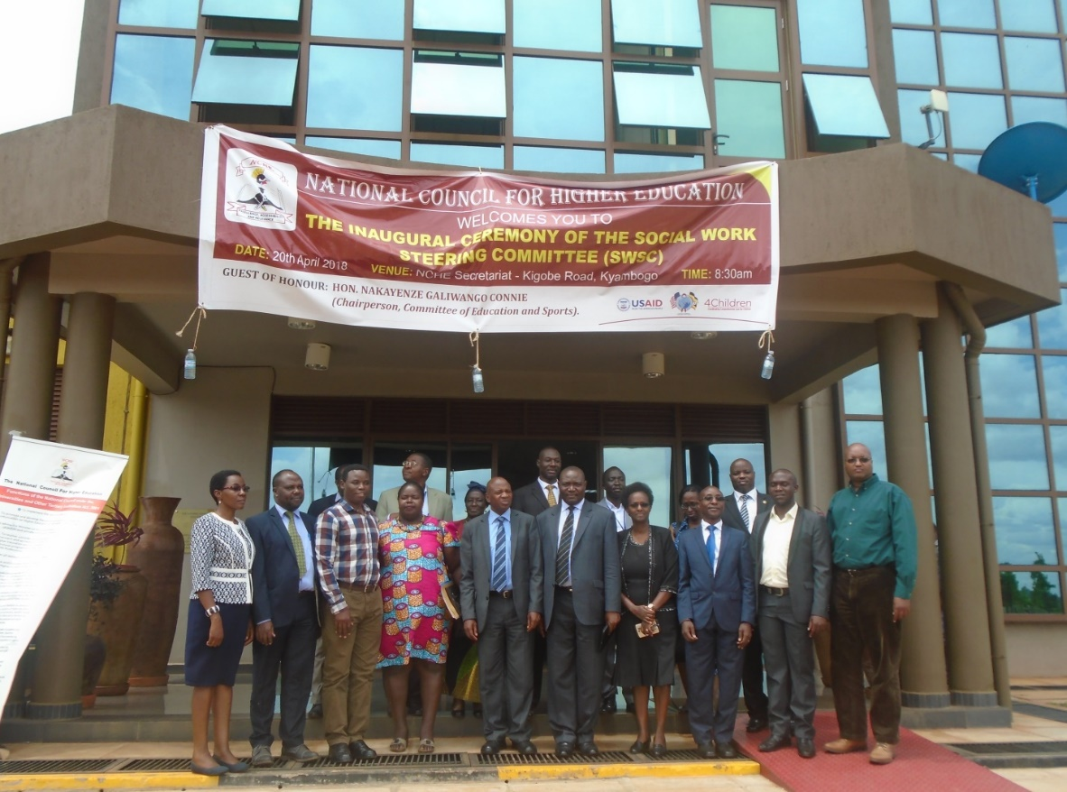
Setting Standards for Social Work Training
4C Contribution to Strengthening the SSW:
Strengthening the quality of social work graduates

Slide 16
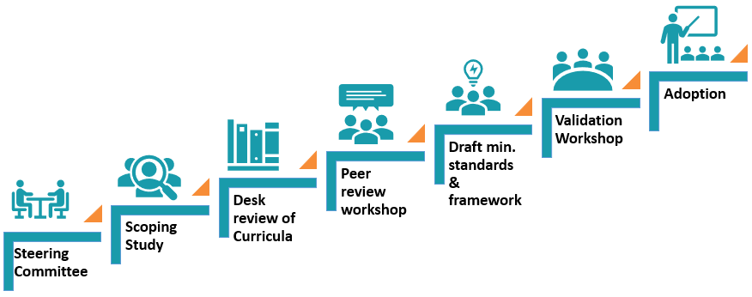
Strengthening Social Work Training
APRIL 2018 JUNE 2019

Slide 17
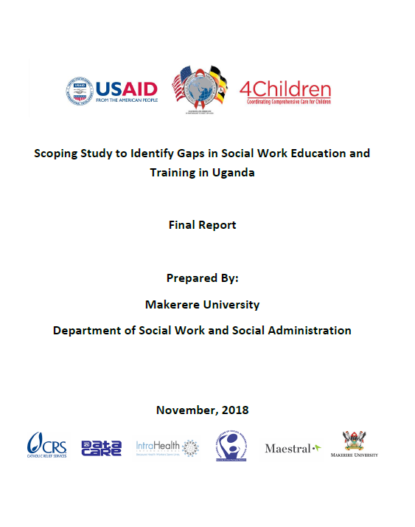
Informed by Research
Lack of a standardized graduation course load across all institutions.
Low dosage of social work knowledge base in some institutions.
Discrepancies in field work and research requirements.
Limited teaching and reference materials available for lecturers.
Lack of standard benchmarks for graduation.
Under-qualified educators in some institutions.
18 Universities
13 Social Work Agencies
3 Policy Makers
280 Students

Slide 18





Core Competencies & Minimum Standards
KNOWLEDGE
VALUES
BEHAVIOURS
SKILLS
ATTITUDE
Under the guidance of the National Council for Higher Education, the Social Work Steering Committee:
Established teaching qualifications for Social Work Training.
Standardized course load with core courses.
Agreed on the required knowledge base for Social Work Programs.
Agree on field work and research requirements
Set standard benchmarks for graduation.

Slide 19
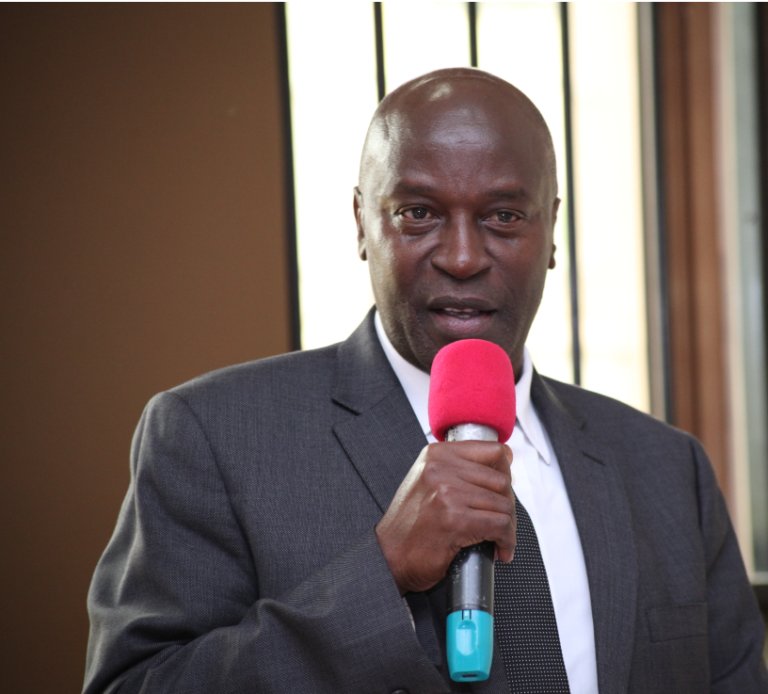

“These minimum standards speak to the contemporary demands of the world of work and should therefore help to produce graduates who will be relevant and can contribute to development.”
Dr. Eli Katunguka, Chairman of the National Council for Higher Education and Vice Chancellor of Kyambogo University
In less than one year, 8 of 18 Uganda Universities have revised
their curriculum and submitted for re-accreditation.

Slide 20
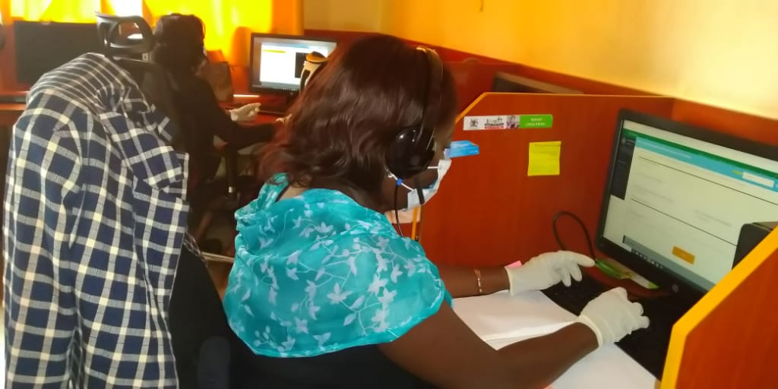

Use Data to Strengthen the Case Management Response
4C Contribution to Strengthening the SSW:
Support the workforce to meet the needs of children in adversity – especially those at increased risk of HIV

Slide 21
Strengthened Response
(Sexual Violence Cases reported to the National Child Helpline)

Slide 22
Using the data to strengthen the response
Implementing a data review to ‘tell the story’ with simple charts and testimonies to spark reflection, connection, dialogue, and action.
Spark renewed effort
Inspire a caring response
Create safe space for reflection
Simplify and package data for accessibility

Slide 23
Supporting the District SSW to Use Data to Strengthen the Response
Learn from Child Helpline Study & Interventions
Adapt the methodology
Review, package, analyze CM data at district-level
Support reflection and inspire action.

Slide 24
Case Management Data Review (30 Districts)
Police were handling most child protection cases.
Case plans were absent in 69.9% of cases.
No documented referral in over 78% of cases.
Less than half of survivors of sexual violence were referred for HIV testing.
8.4% of survivors referred for HIV testing tested positive (n=11); ART enrolment status not indicated/unknown in nearly all cases.
In 91.5% of the sexual violence cases reported within 72 hours, access to post-exposure prophylaxis was not indicated.

Slide 25
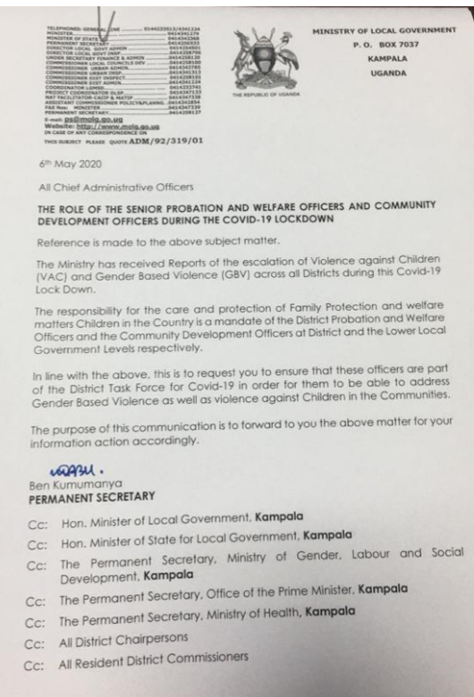
Switching to a Virtual Mode of TA amid COVID-19
Weekly calls to the SSW
(24 districts).
Providing mobile data to support remote work
(Android Tablets).
Promoting the use of social media to support a coordinated response.
Updating the SSW App to disseminate COVID-19 information.
Regular liaison with government at national-level regarding the protection response.
SSW are recognized as Essential Service Providers in the COVID-19 response

Slide 26
Switching to a Virtual Mode of TA amid COVID-19
Survey on Virtual TA: August 2020 (n=57)
 | Strongly agree | Agree | Disagree | Strongly disagree
Gained new knowledge on CM | 51.0 | 33.3 | 2.0 | 13.7
Feel more confident to carry out duties | 43.1 | 39.2 | 3.9 | 13.7
Feel more connected to other colleagues | 43.1 | 42.2 | 2.0 | 13.7
Helped me to complete e-learning course | 54.9 | 25.5 | 11.8 | 7.8
Helped me do my work better | 51.0 | 37.3 | 2.0 | 9.8
77.2% of those surveyed indicated that the virtual TA met their needs.
90% of PSWOs and Senior CDOs would continue to participate in virtual TA.

Slide 27
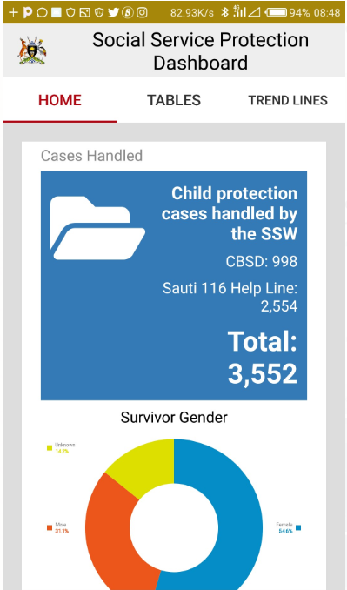
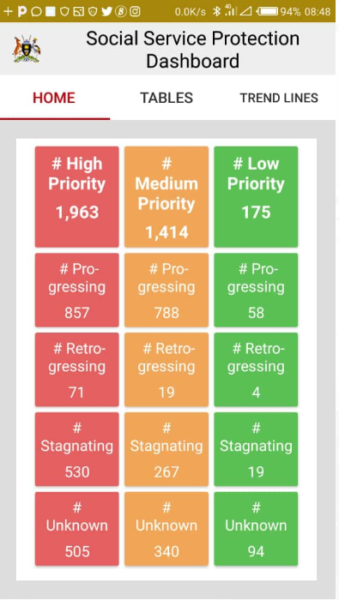
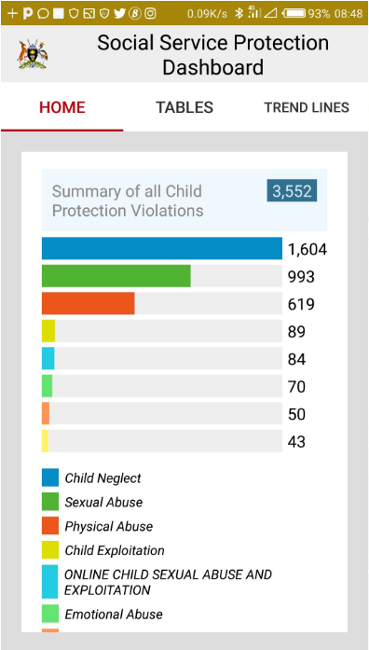
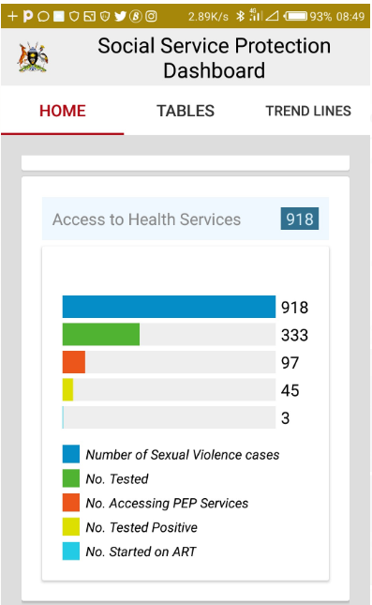
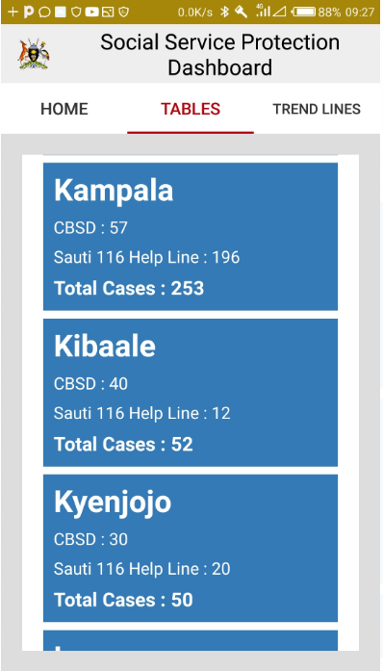
Dashboards to Support & Monitor the Response
PENDING APPROVAL FOR NATIONAL ROLL-OUT
Track progress on critical cases
Types of child protection violations
Monitor critical linkages:
HIV Cascade
Monitor caseload/district

Slide 28
Reflecting on the Journey
Strengthening the SSW to meet the needs of
children affected by HIV & other adversities.
GOAL
Data use to improve response
Standardized
training
Policy
Dissemination
Harmonized case management approach
and package

Slide 29
  Protection policies have been disseminated at-scale to the district SSW…and they are using them!
  Case management procedures and tools are standardized…and practice is improving!
  Universities are revising their curriculum according to the new standards …and the next generation of social workers will have the required competencies
  Continuing professional development courses have been rolled out …and there is a high level of demand.
  Government is using data to advocate for the workforce…and they have secured increased funding .
Strengthening the SSW to meet the needs of
children affected by HIV & other adversities.
GOAL
Data use to improve response
Standardized
training
Policy
Dissemination
Harmonized case management approach
and package

Slide 30
Remarks

Slide 31

Michael Byamukama President, NASWU Country Director, REPSSI

Slide 32

Birgithe Lund-Henriksen Chief of Child Protection, UNICEF

Slide 33
Question & Answer

Slide 34
Thank you!
Continued Success on the Journey!
This presentation is made possible by the generous support of the American people through the United States President’s Emergency Plan for AIDS Relief (PEPFAR) and the United States Agency for International Development (USAID) under cooperative agreement AID-OAA-A-14-00061. The contents are the responsibility of the Coordinating Comprehensive Care for Children (4Children) project and do not necessarily reflect the views of USAID or the United States Government.

