Slide 1
Adherence to Pediatric HIV Treatment
A training for Lay Workers, OVC Case Managers and Community Health Workers
Version 1 August 2021
Notes:
This training is about Adherence to Pediatric HIV Treatment.
The training is specific for Lay Workers, Orphans and Vulnerable Children (OVC), Case Managers and Community Health Workers.
For the purpose of this training, our working definition of “pediatrics” is from ages zero (0) to nine (9) years of age; 10 to 19 are considered adolescent group. This does not preclude you from using these materials for adolescents 10+ age (or young adults in need, for example) who might be struggling with treatment issues

Slide 2
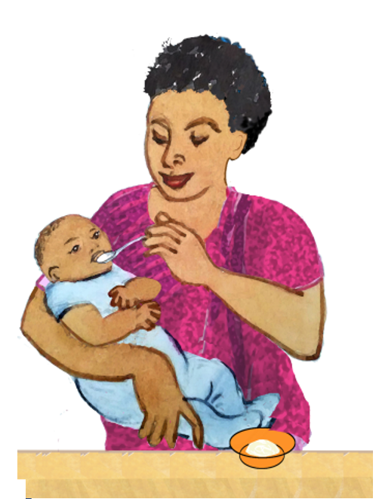
This project has been supported by the President’s Emergency Plan for AIDS Relief (PEPFAR) through the U.S. Centers for Disease Control and Prevention (CDC) under the terms of U2GGH000994
All photographs and illustrations courtesy of ICAP
Notes:
This project has been supported by the President’s Emergency Plan for AIDS Relief (PEPFAR) through the U.S. Centers for Disease Control and Prevention (CDC).

Slide 3
Facilitator Guidance
Notes:
We shall start by providing facilitator guidance. Slides #3 & 4 can be hidden or skipped when doing the training itself with participants.

Slide 4
Who are the Trainers and Trainees?
Trainer:
Facility staff (or pool of national trainers if applicable) who are subject matter experts
Follow country program protocol to determine most appropriate trainer(s)
Trainees:
Lay Workers
Orphans and Vulnerable Children (OVC) Case Managers
Community Health Workers (CHWs)

Slide 5
Before the Training: Prepare
Review Training Content
Review slides with a single star (*) and adapt to country context/guideline as appropriate
Gather Materials
Samples of the commonly available pediatric/adolescent fixed dose combination ARVs for the show and tell portion of the training
If samples are not available, use empty boxes or create a slide with pictures of the available ARV formulations
Antiretroviral therapy (ART) adherence and viral load monitoring standard operating procedures (SOPs)
Flip charts and tape
Markers/pens
If available, provide electronic link to national pediatric treatment guidelines (slide #80)
Notes:
THIS SLIDE SHOULD BE HIDDEN WHEN DELIVERING THE ACTUAL TRAINING
Before the training, the facilitator should gather any documents and materials listed on this slide prior to the training. These documents will be referred to during this training.
Please also think of ground rules in advance in case participants are not able to produce them.
It is recommended to use pictures that are specific to the products that are available in country as different brands may look different
The implementing partner should plan to substitute all of the antiretrovirals (ARVs) pictures (before conducting the training) in this slide deck with pictures of specific ARVs available in country.

Slide 6
During the Training: Introductions
Introduce yourself as the training facilitator
Ask each participant to introduce him/herself
Name
Implementing partner or facility they represent
Role
Any prior training on ART or pediatric HIV
Any other relevant information
Notes:
The Facilitator: introduce yourself to the participants and let each participant introduce him/herself stating name, implementing partner they represent, any prior training on ART or pediatric HIV, etc.

Slide 7
Getting Started
Notes:
Now, lets get started. The facilitator should explain to participants that interactive questions and sharing of one’s own experiences will be used during the training to ensure active participation, which is encouraged.

Slide 8
Purpose of Training
Lay health workers*, OVC case managers, and community health workers can play an important role in pediatric HIV treatment adherence.
By understanding the basic principles of HIV treatment you can:
Help children living with HIV successfully treat their HIV so they can be healthy, grow and thrive;
Help caregivers provide appropriate support to their children to adhere to HIV treatment
*A member of the community who has received some training to promote health or to carry out some health-care services, but is not a health-care professional
Notes:
The purpose of the training: facilitator to read the two bullets.
Encourage the participants to take ownership over their learning in ensuring that they understand what is set forth with the objectives and what is presented in each section.
As a group, agree on the ground rules to be adhered to during the training.
Please Note: for the definition of lay health worker please follow your national guidelines/definition to be consistent in country.
Facilitator, inform participants that generally caregivers’ understanding of treatment literacy for CLHIV is low. Involving caregivers is important to help address issues of clinical optimization and/or other factors that impact adherence and viral load suppression children.

Slide 9
Training Objectives
After completing this interactive training, you will be able to:
Gain knowledge of basic pediatric ART and adherence
Clarify the role of OVC Case Managers, Community Health Workers and Lay workers in the clinical management of HIV.
Use simple Observation Assessment Skills to support families and caregivers in addressing challenges with HIV treatment adherence among children and adolescents living with HIV.
Notes:
Facilitator to state the training objectives by reading the slide.

Slide 10
Training Outline
Purpose and Training Objectives (Slides #8 & 9)
Roles and Responsibilities (Slides #12-13)
Understanding HIV medicines (Slides #16-23)
HIV treatment adherence and viral load (Slides #24-32)
ART for children (Slides #33-39)
Considerations for giving Pediatric ARV formulations (Slides #40-43)
Administration of ARVs (Slides #44-56)
Administration Challenges and Solutions (Slides #57-65)
Supporting caregivers (Slide #66)
Referrals (Slides #67-69)
Practical Scenarios (Slides #72-75)
Checklist (Slides #76-79)
Notes:
This is a list of topics that will be covered in this training, it can also serve as an agenda
Adapt the agenda to suit your training plan.
Use your best judgment as to when the participants need a short stretch break, a longer break, and a break for lunch.
Always allow time for questions and comments.

Slide 11
Suggested Training Duration
Purpose and Training Objectives (Time 5min)
Roles and Responsibilities (Time: 15min)
Understanding HIV medicines (Time: 30min)
HIV treatment adherence and viral load (Time: 50min)
ART for children (Time: 30min)
Considerations for giving Pediatric ARV formulations (Time: 25min)
Administration of ARVs (Time: 40min)
Administration Challenges and Solutions (Time: 40min)
Supporting caregivers (Time: 5min)
Referrals (Time: 15min)
Practical Scenarios (Time: 60min)
Checklist (Time: 15min)
Suggested Training Time: 330min/5.5hrs
Notes:
This is a list of topics that will be covered in this training
Adapt the agenda to suit your training plan, and adjust the time as needed
Use your best judgment as to when the participants need a short stretch break, a longer break, and a break for lunch.
Always allow time for questions and comments.
Facilitator to inform the participants that Roles and Responsibilities refers to those of Lay workers, Case managers, and Community Health Workers

Slide 12
What Is Your Role?
During a home visit, the Lay worker, Case Manager, or Community Health Worker plays a supportive non-clinical role.
Depending on your national guidance and formal training psychosocial support maybe provided directly, otherwise should be referred for expert support
Notes:
Facilitator to explain the roles of Lay Worker, OVC Case Managers and CHWs by reading the slide.
Facilitator: Ask them to describe the work they do. Identify each cadre among the participants and ask them to describe what they do very briefly. Ask them how do their roles differ from that of facility health care workers.

Slide 13
What Are Your Responsibilities?
Lay workers, Case managers, and Community Health Workers are expected to support OVC beneficiaries living with HIV to improve their adherence to HIV treatment.
This support can be provided either directly (where feasible) or through support and referral to health facilities.
Support can include:
Identifying HIV treatment administration challenges and making appropriate referrals
Helping caregiver understand and appreciate the relationship between HIV treatment adherence and viral load.
Advise caregiver when to return to the facility
Notes:
Facilitator to explain the responsibilities for the Lay Worker, OVC Case Managers (CMs) and CHWs by reading the slide.
Emphasize that this training aims to assist Lay workers, OVC CMs and CHWs in supporting treatment adherence and viral suppression either directly (where feasible) or through support and referral to health facilities. The training offers basic information and considerations for CHWs and Lay workers to help them have knowledge and understand the basic concepts of pediatric ART, adherence and viral load monitoring.
Facilitator may cite challenges such as socio-economic issues, fears of stigma, relationships issues disclosure, and other common issues impacting adherence in children. Specific challenges and suggested solution will be discussed in subsequent slides.

Slide 14
What Are you NOT Expected to Do?
Lay workers, Case Managers and Community Health Workers are not expected to perform the following responsibilities of clinical staff:
Correcting dosing of HIV treatment,
Counting pills,
Offering advice on changing HIV medicines,
Providing other clinical management.
Notes:
Facilitator to explain expectations for the Lay Worker, OVC Case Managers and CHWs by reading the slide.

Slide 15
Questions?
Notes:
Facilitator: open the floor up for questions and answers

Slide 16
Understanding HIV Medications
Notes:
The following session will focus on understanding HIV Medications.

Slide 17
How is HIV treated?
When someone is diagnosed with HIV, they should start taking medicine as soon as possible to treat their HIV.
You may hear and see a lot of words and letters used to describe medicines that treat HIV, such as:
Antiretroviral or ARV
Antiretroviral Therapy or ART
Formulation
Regimen
Understanding the different terms for HIV medicines will help you better support your patients living with HIV.
Notes:
How is HIV treated? Facilitator to read the slide.
Remind participants that OVC CMs, CHWs and Lay workers’ role is supportive and not to provide clinical advice (including not providing psychosocial support (from professional clinical diagnosis standpoint, for example) which should be done at the facilities or social support service by experts).
Encourage participants to always refer the caregiver/patient to the health facility for additional support as needed

Slide 18
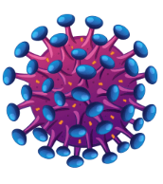
What are ARVs?
“ARVs” is a shorter term that refers to Antiretrovirals
Breaking down the term Antiretrovirals
“Anti” means against
HIV is a type of virus called a retrovirus
Antiretroviral = against a retrovirus = Against HIV
Notes:
Facilitator engage the participants by asking them: What are ARVs? (probing question Can you define for your peers?)

Slide 19
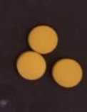
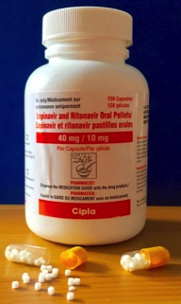
What is an ARV Formulation?
Medicine can come in many different forms.
A single type of ARV can be made in different forms that
look different
have different amounts of medicine
are given or taken in different ways
These different forms of a single type of medicine are called ARV formulations
? What are some ARV formulations you know about?
Lopinavir/ritonavir (LPV/r) Tablets
LPV/r Pellets
LPV/r Solution
LPV/r Granules
Notes:
What is an ARV formulation? Facilitator to read the slide.
Note to facilitator- adjust this slide to reflect only those formulations of Lopinavir/ritonavir (LPVr) that are available in the country program.
Recommend updating photos here

Slide 20
What is an ART Regimen?
An ART regimen is a combination of at least three ARVs that fight HIV together
Three ARVs taken together are stronger against HIV than one ARV taken alone
We also call this Antiretroviral Therapy or ART
Notes:
What is an ART regimen?
Facilitator to read the bullets on this slide.

Slide 21
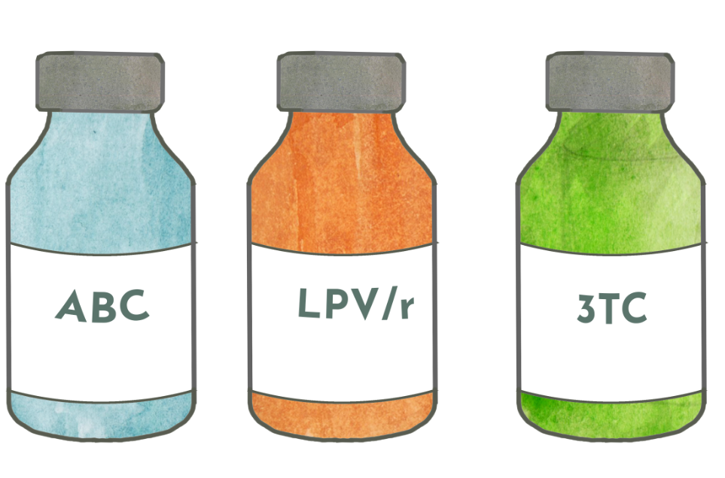
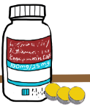
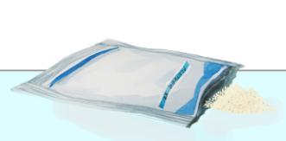
ARV vs. Formulation vs. Regimen
An ARV is a medicine that treats HIV. There are several types of ARVs.
ARVs can come in different formulations.
An ART regimen is at least three different ARVs given together
ABC = abacavir
LPV/r Liquid
LPV/r Tablet
LPV/r = lopinavir/ritonavir
Some formulations can include multiple ARVs. For example, a patient may be able to receive all 3 of the ARVs their ART regimen through only one or two different pills
LPV/r Pellets/
Granules
3TC = lamivudine
Notes:
Facilitator should adjust slide to reflect the LPV/r formulation used in the program (pellets or granules)
At the end of this slide, ensure all participants understand the difference between ARV, ART regimens, and ARV formulations.

Slide 22
Questions?
Notes:
Facilitator: open the floor up for questions and answers

Slide 23
HIV Treatment Adherence & Viral Load
Notes:
The following section will focus on HIV Treatment Adherence & Viral Load.

Slide 24
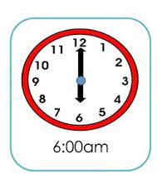
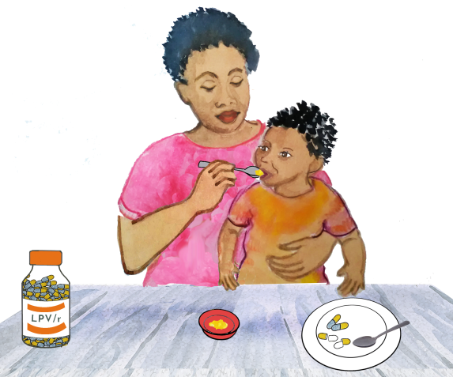
ART Adherence
ART Adherence means:
taking the right drugs
at the right dose
at the right time
EVERY DAY!
Notes:
Read the slide

Slide 25
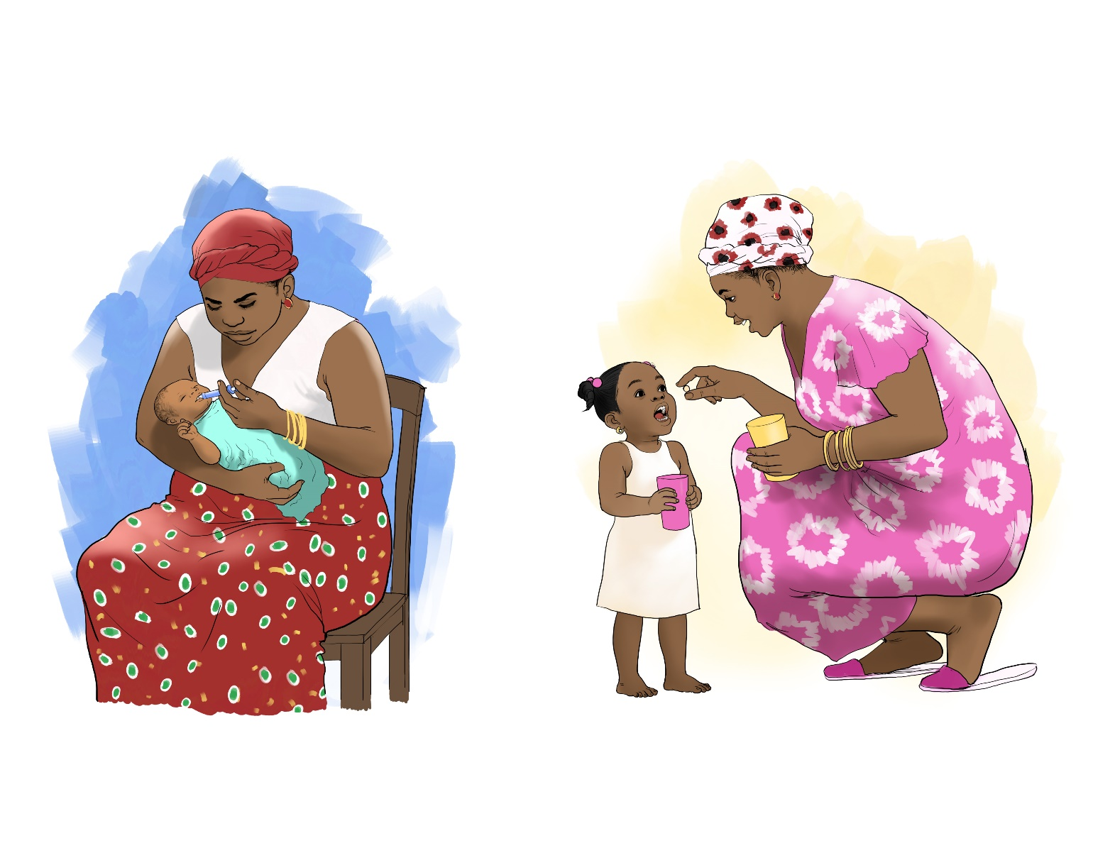
Why is ART Adherence Important?
ARVs fight HIV and keep the amount of HIV in the blood low.
Children and adults living with HIV always need to have ARVs in their blood to keep the amount of HIV in their blood low.
It’s important to take your ARVs as prescribed
Notes:
Why is ART adherence important? Read the slide.

Slide 26
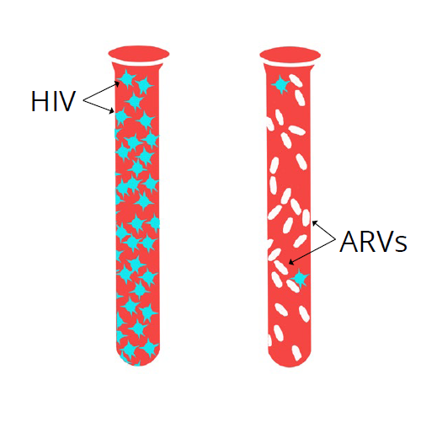
What is a Viral Load (VL)?
A viral load is a measure of how much HIV is in the blood.
The viral load provides information about how well ARVs are working.
ARVs stop HIV from making more virus.
VL testing frequency per World Health Organization: 6 months after ART initiation, 12 months after initiation yearly thereafter. However, follow your country guidelines
Notes:
What is a viral load? Read the slide.
Undetectable equals untransmittable (U=U) means that people with HIV who achieve and maintain an undetectable viral load—the amount of HIV in the blood—by taking antiretroviral therapy (ART) daily as prescribed cannot sexually transmit the virus to others.
Undetectable viral load means the patient’s viral load result is less or equal to 50 copies/ml.
Source WHO VL testing frequency: https://www.who.int/news/item/17-03-2021-who-publishes-new-clinical-recommendations-on-hiv-prevention-infant-diagnosis-antiretroviral-therapy-initiation-and-monitoring

Slide 27
Importance of adherence to ART
It is important for people living with HIV to take their ARVs every day at the same time
If a dose is missed, the amount of ARVs in the blood may be too low to stop HIV from making more virus.
When the ARVs in the blood are too low, the virus can also learn how to fight the medicine.
When the virus begins to fight the medicine, it makes it harder for the ARVs to keep the viral load low.
No ARVs
ARVs
Notes:
Importance of adherence to ART: Read the slide.

Slide 28
When the Viral Load is LOW
A low viral load means less than 1000 copies/milliliter (mL)
Also, that a patient is taking their ARVs well and they are working. It means that the patient is virally suppressed.
This doesn’t mean they can stop ARVs.
Patients need to continue to take their ARVs every day!
Encourage them to keep up the good work!
Notes:
When the Viral Load is LOW: Read the slide.
Facilitators should update high VL to match national guidelines, since some countries use different cutoffs

Slide 29
Undetectable equals Untransmittable (U=U)
U=U means that people with HIV who achieve and maintain an undetectable viral load cannot sexually transmit the virus to others.
Undetectable viral load means the patient’s viral load result is less or equal to 50 copies/mL
Taking antiretroviral therapy (ART) daily as prescribed helps to achieve U=U status
Source: WHO (2021). Updated recommendations on service delivery for the treatment and care of people living with HIV. Updated recommendations on service delivery for the treatment and care of people living with HIV (who.int)

Slide 30
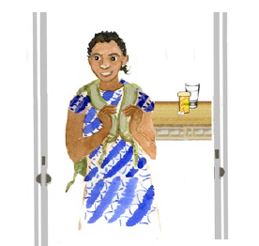
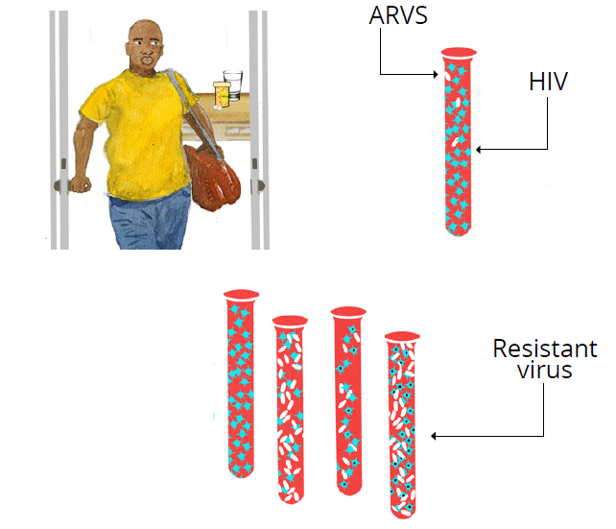
When the Viral Load is HIGH
A high viral load result of ≥1000 copies/mL
means HIV is not controlled, and it is harming the body and brain.
The patient may be missing doses of their ARVs.
The virus may be resistant, meaning it has changed and the current ARVs are no longer working.
DO NOT make a child, adolescent or caregiver feel guilty if the VL is high, but rather discuss challenges & solutions
Notes:
Facilitators should update high VL to match national guidelines, since some countries use different cutoffs
When the Viral Load is HIGH: Read the slide.
Some children may have good adherence but have drug resistance and that is the reason for their high VL (especially children still on NNRTIs).
The facilitator should make it clear that further investigation for the reason for high VL (adherence or administration vs resistance) and management of the patient is for clinical staff.
Facilitator: Should emphasize to the participants that a patient/client should not be incriminated or made to feel guilty if the VL is high. It is an opportunity to discuss challenges and how the client, clinic, and case manager, et al can work together to overcome them.

Slide 31
How To Support Caregivers to Ensure Adherence
Group work (20 minutes) Consider how you communicate with the families:
List common situations faced by families of children living with HIV and identify some common strategies that CHWs and CMs can use to help families address these common situations.
Discuss the importance of ART adherence with caregivers
Help caregivers anticipate situations that might interfere with adherence
Strategize with caregivers about how to maintain adherence in these situations
Notes:
Facilitator give them 10 minutes to discuss among themselves, depending on the number of groups, you might want to give each group just one question to focus on. Instruct them to identify a spokesperson who’ll report out on behalf of the group (only 10 minutes total so each group approx. 3 min each). After each group has shared, highlight main observations from each of the four scenarios.
NB!: Facilitator should emphasize communicating with caregivers is a skill. Draw on participants experience here– when they’re sharing ask how do they enter the household, how do they engage caregivers in discussion, how do they develop trust and create space for honest discussion?
#1 Determine common challenges with adherence faced by families and suggest strategies to address those challenges
How To Support Caregivers to Ensure Adherence:
#2. Discuss the importance of ART adherence with caregivers.
Keeps their child’s viral load low
Keeps their child healthy
Helps the medicine fight HIV so it doesn’t become resistant
Continue by reading line #3
A few examples from the facilitator;
Caregiver planning to travel, leaving children with other relatives
Children or adolescents beginning boarding school
Pregnant mother nearing time of labor and delivery
Family members visiting from out of town
Non-disclosure of HIV status may prohibit (or cause) medication or ARV administration challenges
Sickness, bereavement and loss of a parent or caregiver
Continue to #4
Strategize with caregivers about how to maintain adherence in these situations
Identify an alternate caregiver for the child and ensure they understand correct dosing, timing, and administration of all medications
Identify possible alternate locations for storage of medications
Facilitator proceed to read the bullets below
The CHW can assist caregivers to address or plan for anticipated changes that might interfere with medication administration/adherence
Example: mother planning to travel leaving children with other relatives, or children travelling to boarding school, a pregnant mother-if she goes into labor

Slide 32
Questions?
Notes:
Facilitator: open the floor up for questions and answers

Slide 33
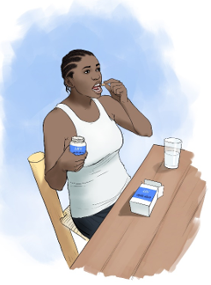
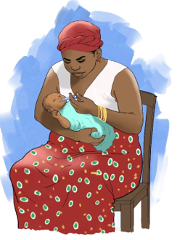
ART for Children
Notes:
Proceed to the next slide for more explanation.

Slide 34
ART for Children
Children are growing rapidly; their weight impacts the dose of ARVs they should receive
The developmental stages of children also vary
Developmental stage impacts a child’s ability to swallow pills
Notes:
Facilitator to read the bullets below;
Children have different shapes and sizes, but they are also growing. Their weight impacts the dose of medications that they should receive.
Children are at different developmental stages, which impact their ability to swallow ARVs. The choice of ARV formulation must be tailored to their developmental stage, considering their swallowing ability.
Remind participants that dosing and selection of ARV formulations and ART regimens will be determined by facility staff. However, CHWs and CMs can help identify challenges that caregivers are facing with getting their children to take the medicines as prescribed, and refer caregivers facing challenges to the facility for further management by a healthcare provider.

Slide 35
How are ARV different for adults and children?
ARV dosing is generally the same for all adults
Adult bodies are no longer experiencing the rapid development of childhood and adolescence and their bodies will all process ARVs in mostly the same way
Notes:
Remind participants that CHWs and Lay worker their role is supportive and not clinical. Encourage participants to always refer the caregiver/patient to the health facility for additional support as needed.

Slide 36
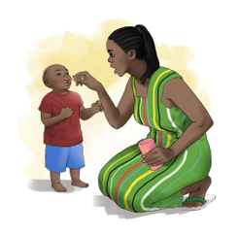
Liquid ARVs for Children
Strengths
Liquid ARVs can be swallowed even by young infants.
Known Challenges
Keeping some liquid ARV cold can be difficult.
Older children need to take large amounts of liquid ARVs.
Some liquid ARVs can have a bitter/unpleasant taste that children may not like.
Measuring the correct amount of liquid ARVs to administer may be difficult.
Notes:
Facilitator read the bullets on the slide and emphasize on other key points highlighted below;
Now we will review some of the commonly available ARV formulations, starting with liquid formulations.
Other key points
As the baby grows and gains weight, dosing can be adjusted at the health facility (by a nurse or clinician or pharmacist per your national guidelines) by giving different amounts of liquid ARVs
Older/ heavier children may be prescribed more than one bottle, which can be heavy to carry and take up storage space
Some liquid ARVs need to be kept cold
Some liquid ARVs taste very bitter
measuring the correct amount of liquid ARVs to administer maybe difficult
The challenge could be related to, or a result of, literacy of caregivers, tools used for measuring or a host of other problems.

Slide 37
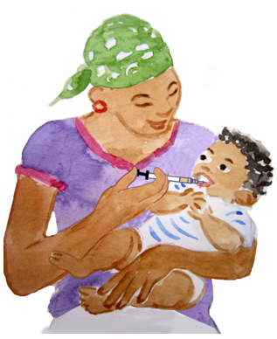
Liquid ARVs can be used in young infants and are rarely used in children who can use “dissolvable formulations”
Liquid ARVs are used in the prevention of mother-to-child transmission (PMTCT) of HIV (infant prophylaxis)
Notes:
Facilitator read the bullets on the slide.
Prophylaxis ARV given to an infant or child to prevent acquiring HIV

Slide 38
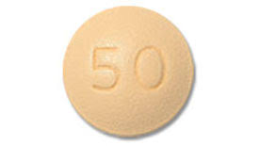
ARV Tablets for Children: Film coated vs. Dispersible
Film coated tablets
Film coated tablets must NOT be crushed or broken but must be swallowed whole.
Dispersible
Dispersible tablets can be crushed, broken, or dissolved in liquid.
Dispersible tablets can also be dissolved in the mouth.
Dispersible tablets may be easier to take, especially for children who cannot swallow tablets.
Dolutegravir (DTG) 50mg
Pediatric Dolutegravir (pDTG) 10mg scored tablet
Notes:
Facilitator read the bullets on the slide and emphasize on the two bullets below;
Emphasize that some tablets must be swallowed whole while other tablets may be crushed, broken, or dissolved in water or milk
Before breaking or crushing a tablet to give to a small child, check with a healthcare worker to make sure it is okay

Slide 39
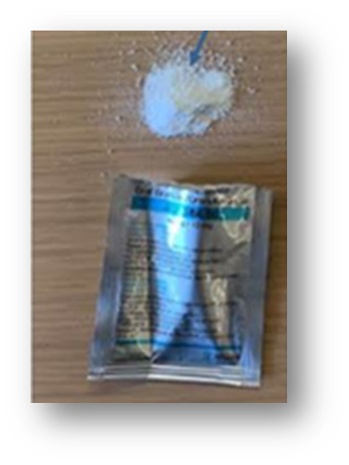
Pellets and Granules for children
LPV/r pellets come inside a capsule which must be opened to release the pellets
LPV/r granules come inside a sachet which must be opened to release the granules powder
Notes:
Facilitator read the bullets on the slide and emphasize on the two bullets that;
for pellets the capsule must be opened to release the pellets and,
for the granules the sachet must be opened to release the granules which are in powder form.
Facilitator to remind participants that administration of pellets and granules will be covered in subsequent slides

Slide 40
Questions?
Notes:
Facilitator: open the floor up for questions and answers

Slide 41
Considerations for Giving Pediatric ARV Formulations
Notes:
Facilitator to read the slide and proceed to the next slide

Slide 42
Names of ARVs used in children
Name of ARV | Abbreviation | Class of ARV
Dolutegravir | DTG | Integrase Inhibitor (INSTI)
Raltegravir | RAL
Lopinavir/ritonavir | LPVr | Protease inhibitor (PI)
Zidovudine | AZT | Nucleoside Reverses Transcriptase Inhibitor (NRTI)
Abacavir | ABC
Lamivudine | 3TC
Tenofovir | TDF
Nevirapine | NVP | Non-nucleoside reverse transcriptase inhibitor (NNRTI)
Efavirenz | EFV
Notes:
Facilitator to inform participants that this table is included here for reference only, and to encourage participants to familiarize themselves with these names just so they become aware. A CHW, CM, or Lay Worker going into households may see these ARVs in the patient’s home.
This is the show and tell time for participants to see common ARVs available in their country program.
Reminder to the facilitator:
Prior to starting this training, the facilitator should add commercial/or common names of the formulations or fixed dose combinations available in country.
Ideally, have samples of these during the training to show participants.
Emphasize that lay workers, CHW, and CMs do not need to know all the details in this table but can use this as a reference if needed.

Slide 43
ARV Formulations used in children
Some formulations only have 1 ARV drug
Single ARVs | AZT | Liquid
 | NVP | Liquid or dispersible tablet
 | EFV | Tablet
 | LPVr | Liquid, pellet, granule or tablet
 | DTG | Film coated tablet or dispersible tablet
 | RAL | Chewable tablet
Some formulations combine 2 or 3 ARV drugs
Fixed dose combination (FDC) | ABC/3TC | Dispersible tablet
 | AZT/3TC | Dispersible tablet
 | AZT/3TC/NVP | Dispersible tablet
 | TDF/3TC/DTG (TLD) | Film coated tablet
Notes:
Some of the ARVs exist in combination, others have one drug. Here is a reference list.
Remind participants that CHWs, CMs and Lay worker their role is supportive and not clinical. Encourage participants to always refer the caregiver/patient to the health facility for additional support as needed.
The facilitator should emphasize to the participants that: “As previously discussed on slides 17 and 18, a regimen is all three drugs given together”.

Slide 44
Pediatric ARV formulations: Based on weight and developmental level
DTG 10mg can be used in children ≥ 3kgs and ≥ 4 weeks old
DTG50 mg single tablets can be used in children ≥20kgs
TLD can be used in children and adolescents ≥30kgs
LPVr syrup and granules can be used in children ≥ 2 weeks old*
*WHO 2021 ART guidelines recommend first-line DTG-based regimens for all children living with HIV (CLHIV) 4wks+ & 3kg+ with LPV/r now an alternative regimen
Notes:
The main point that we want the facilitator to get across to participants is that pediatric ARVs formulations are prescribed by clinician/facility staff based on weight and developmental level. Also read the bullets below:
In general, TLD recommended in children and adolescents who weigh >= 30kgs (check the weight cut off with your country’s national treatment guidelines)
DTG 50mg single tablets recommended in children who weight >=20kgs
DTG 10 mg dispersible tablets recommended in children who are >=4 weeks and weight >=3kg until 20 kg
LPV/r formulations (syrup, granules can be used in children >= 2weeks old while pellets can be used in children >=3months able to swallow pellets)
LPV/r tablets must be used in children who are able to swallow tablets WHOLE
Please note that based on the current 2021 World Health Organization (WHO) Recommendations DTG-based regimens are preferred first-line for all CLHIV and that LPV/r is moving to an alternative first and second-line regimen
Remind participants that ARVs will be prescribed by facility staff/clinician
Remind participants that DTG 10, DTG 50 and TLD are newer ARVs for children; thus, they maybe mentioned a lot at the facilities or by the patients. So you should be familiar, but you will NOT prescribe.

Slide 45
Administration of Pediatric Dolutegravir (pDTG)
Scored
pDTG 10mg scored, dispersible tablet (DT) is a new formulation of DTG used for children aged ≥4 weeks and weigh between 3- <20kg
Dispersible formulation allows pDTG to be easily administered to children by dissolving the medicine ideally in a small amount of water (teaspoons of clean water)
pDTG can also be swallowed whole.
The amount of water to use will be recommended by health facility staff
Crushing, chewing or mixing with other foods or liquids can be considered as long as the child can consume the entire amount of liquid or food.
The caregiver should stir until the tablet(s) dissolves and help the child to drink.
pDTG 10mg scored. DT tablet
pDTG 10mg scored. DT tablet dissolved in water
Notes:
Facilitator: as mentioned on the previous slide, pediatric Dolutegravir in the forms of DTG 10 milligrams, DTG 50 milligrams are newer ARVs for children. We want to give you a little bit more information on them so that you can help make sure that caregivers give this medication properly to their children.
First, pDTG 10mg scored, dispersible tablet (DT) is a new formulation of DTG used for children who are at least 4 weeks old and weigh between 3 and <20 kilograms. Scored tablet means: the tablet has a line to assist caregiver to break it into two halves per instructions from facility staff
DTG dispersible tablets should be ideally dispersed in water or swallowed whole. Crushing, chewing or mixing with other foods or liquids can be considered as long as the child can consume the entire amount of liquid or food.

Slide 46
The benefits of pDTG
Highest barrier to resistance
Easier to prepare and simpler means of administration in comparison to LPV/r
Only one dose a day compared to twice a day dosing of LPV/r
Improved tolerability
the pDTG dispersible tablet eases ingestion
strawberry flavor makes it more palatable
More potent drug class (integrase inhibitor) helps the child more rapidly achieve viral load suppression
Easily used for multi-months dispensing (MMD)
Notes:
Facilitator: pDTG has several benefits listed on list slide. Just to name a few:
The facilitator should explain to the participants that by pDTG having “higher barrier to resistance” it means that, the DTG10mg cannot be easily overpowered by the HIV virus to the extent it stops working as intended
pDTG is easier to prepare compared to LPV/r; caregivers will only need to give to their children once a day, because of the strawberry flavor kids may enjoy the taste better, and because it dissolves into water quickly it is easily ingested
Facilitator to explain the concept of MMD that multi-month dispensing (MMD) is an aspect of differentiated service delivery that provides patients with 3 or more months of medication and eliminates the need for monthly clinic and/or community facility visits.
Take home message: pediatric DTG is a better, stronger more preferred ARV for children…

Slide 47
*Administration of ARV syrup
A cup or syringe can be used to measure the correct amount of syrup.
The measured amount of syrup should then be given directly into the child’s mouth for him/her to swallow.
* Select this slide based on country context
Notes:
Based on Country-country adaptation; Select this slide if your country guidelines have approved use of syrups (AZT, LPV/r syrup).
Facilitator to remind participants that; in earlier slides we discussed the different ARV formulations. Now let's focus on administration of the different ARV formulations.
Facilitator should also read the additional notes included below
Some children may still be taking LPV/r syrup
The facilitator should let the participants know that LPV/r syrup is to be given morning and evening
Tell the caregiver that if a syrup tastes bitter, it should be given towards the side of the tongue, as the bitterness is mostly tasted in the middle of the tongue
Remember, the child’s dose should be determined by a healthcare provider.
Also remind participants to always refer the caregiver back to the facility in case the caregiver/child is experiencing administration challenges e.g. vomiting, spit etc.
With syrups, it is important for adults to measure the dose correctly using a small cup with measurement markings or a syringe
A cup can be used to pour the correct amount of syrup into the child’s mouth to swallow
A syringe can be used to give the correct amount of syrup directly into the mouth
Facilitator should remind participants that common challenges and potential solutions will be discussed in subsequent slides

Slide 48
* Administration of LPV/r Pellets
LPV/r pellets can be used for children at least three (3) months of age who are not able to swallow LPV/r tablets
This formulation comes in capsules.
A caregiver will open the capsule and release the pellets inside the capsule.
The pellets can then be given to the child with breastmilk or soft foods.
*Select this slide based on country context
Notes:
*Based on Country-country adaptation; Select this slide if your country guidelines have approved use of LPV/r pellets

Slide 49
*Administration of LPV/r pellets (2)
Important things to remember about pellets:
The capsule cannot be swallowed
Pellets cannot be chewed or dissolved
Pellets are small so they may be easy to swallow with liquid or food
The dose for pellets depends on the child’s weight
Pellets can melt and taste bitter if given with hot food or if not given immediately
Many children on LVP/r pellets will likely be transitioned to pDTG in the near future
*Select this slide based on country context
Notes:
Pellets are like very small tablets (refer to the white sprinkles in the picture)- they cannot be chewed or dissolved.
Important: The pellets are what are inside of the capsule. The pellets are the medicine. The capsule cannot be swallowed.
Dose will be determined by the facility staff and refers to the number of capsules to be administered
Remind participants not to prescribe but refer to the clinic for additional support.
The dose for pellets will determine how many capsules should be given –but not for you as the case manager/lay worker to prescribe, but to be aware!

Slide 50
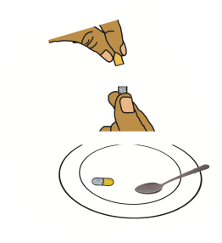
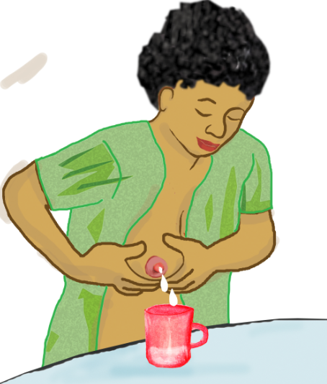
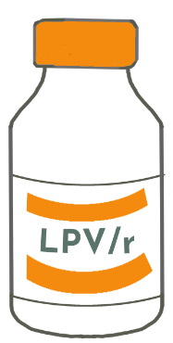
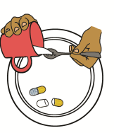
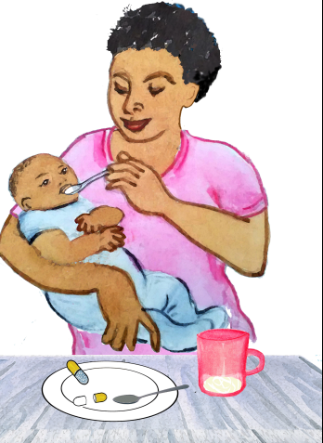
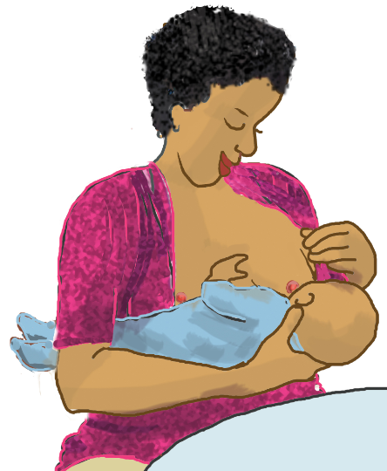
LPV/r pellets preparation steps: Breastmilk
3. Pour pellets into the spoon
1. Express breastmilk
2. Open the capsule (s)
4. Add breastmilk
5. Give it to the baby
6. Breastfeed
Notes:
Facilitator to walk participants through steps 1-6
Always remind the caregiver to administer the full dose (e.g., the two capsules, or three capsules etc. as instructed by facility staff) plus the other prescribed ARVs.
Steps
Express a small amount of breastmilk into a clean cup
Holding the capsule with the yellow side up, twist the yellow side to open the capsule
The pellets will remain in the bottom half of the capsule
Do this over a clean plate in case any pellets spill out of the capsule
Sprinkle the pellets onto the spoon
Add breastmilk to the spoon and administer to the baby.
Repeat these steps until the entire dose has been given.
Breastfeed afterwards

Slide 51
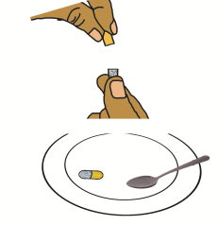
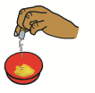
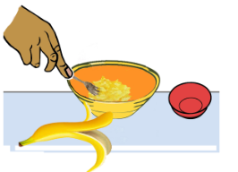
LPV/r pellets preparation steps: Soft/semi-solid foods
2. Sprinkle pellets on small amount of food
1. Open the capsule (s)
3. Mix the pellets and food
4. Feed it to the baby
OR: Pour pellets into a small ball of soft food and feed to the child
Notes:
For children who take pellets with food, remind participants that the caregiver should prepare the food beforehand, before the time of giving the ARV. Do: Facilitator to walk participants through steps 1-4 , also refer to the notes below
Instructors should be aware that only small amounts of food should be placed in the small cup or bowl (equivalent to two or three bites)
Steps:
Holding the capsule with the yellow side up, twist the yellow side to open the capsule
The pellets will remain in the bottom half of the capsule
Do this over the clean plate in case any pellets spill out of the capsule
Sprinkle the pellets over a small amount of soft food. It may help to fold some of the food over to hide the pellets.
Administer the food to the baby.
Alternative administration method for older children: Pour/hide pellets into a ball of soft food and feed the child. You may wash it down with liquid (milk, water, juice, tea etc)
Repeat these steps until all the entire dose has been given.
Remind participants not to use hot food, as this can cause the coating to melt and lead to a bitter taste. Also remind participants not to mix all the capsules at once in a large bowl of food, as the coating can start to melt before the child takes the entire bowl of food and lead to a bitter taste, or the child may not eat the entire amount of food so may not receive the entire dose.
Consider changing some of the foods to ones more common in the local culture/setting (or specific foods that the child likes).

Slide 52
*Administration of LPV/r Granules
Granules are another formulation for children who are not able to swallow tablets.
The dose of the granules is measured by the number of sachets given.
The sachets must be opened to access the powder inside.
Granules can be administered with breastmilk or other soft foods.
*Select this slide based on country context
Notes:
Select this slide if your country guidelines have approved use of LPV/r granules.
This formulation is another option for children who weigh less than 20 kilograms and are not yet able to swallow LPV/r tablets.
Granules come in a sachet, and the dose is measured by the number of sachets. Each sachet must be opened to give the powder inside.
We shall learn about how to administer granules in subsequent slides.
Consider showing participates the actual granule sachet, as part of show-and-tell session.

Slide 53
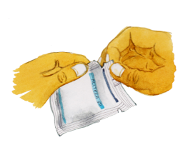
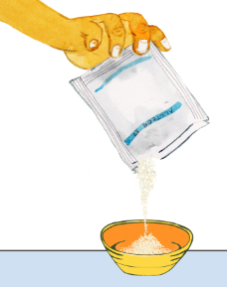
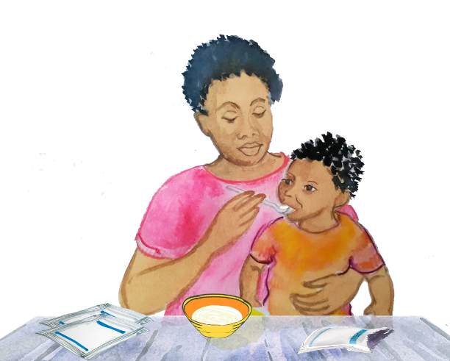
Preparation of LPV/r granules
Starting at the notch, tear off the top of the first sachet of granules to open the sachet.
Empty all the granules into a cup or bowl on top of a small amount of food.
Stir the granules into the food.
Immediately after stirring, feed the mixture to the child using a spoon.
The granules should be given quickly so they do not have time to dissolve and become bitter.
Repeat this process until the entire dose of granules has been given.
Notes:
Facilitator to walk participants through the administration steps.
Steps:
Hold the sachet up so the notches are on the top and the granules settle to the bottom.
Start at the notch and carefully tear the top of the first sachet of granules open and empty all the granules into a bowl or cup with a small amount of food in it
Tap the bottom of the packet to make sure it is emptied completely.
Stir or fold the granules into the food and immediately feed the mixture to your child using the spoon.
It is important the mixture be given quickly before the granules develop a bad taste, and that the child eats the entire mixture of granules and food.
The child should be able to swallow the amount of the mixture in one or two spoonful of food.
If a bad taste develops, you can follow each spoonful of mixture with plain food or something else that he/she enjoys eating. This helps to remove any bad taste from the granules and make sure all the granules are swallowed.
Repeat this process until the entire dose of granules has been given.
Remind participants not to use hot food, as this can cause the coating to melt and lead to a bitter taste. Also remind participants not to mix all the sachets at once in a large bowl of food, as the coating can start to melt before the child takes the entire bowl of food and lead to a bitter taste, or the child may not eat the entire amount of food so may not receive the entire dose.

Slide 54
Administration of LPV/r tablets
LPV/r tablets cannot be dissolved, crushed, broken/split, or chewed
LPV/r tablets MUST be swallowed whole
Children who are taking LPV/r tablets must be able to swallow them whole
If a child who cannot swallow tablets whole has been prescribed LPV/r tablets, refer them back to the clinic to see a health care worker who can change their formulation.
Notes:
The facilitator should emphasize that LPV/r tablets are not dispersible and cannot be split, crushed, chewed, or dissolved. These tablets must be swallowed whole.
If you identify a child on LPV/r tablets who is unable to swallow them whole, refer the caregiver to the facility for a healthcare provider to prescribe a different formulation appropriate for the child’s development/ swallowing ability.

Slide 55
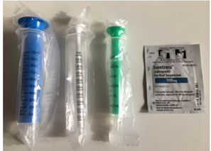
*Administration of RALTEGRAVIR (RAL)
Some HIV-positive neonates (< 4weeks) may be started on a medication called RAL.
RAL comes in the form of granules, which require a caregiver to mix it at home with clean water before giving it to their baby.
RAL dosing changes with the weight and age of the baby, so caregivers may need support to make sure they give the correct dose as their baby grows.
RAL must be mixed and given exactly as instructed by facility staff.
*Select this slide based on country context
Notes:
Select this slide if your country guidelines have approved use of RAL granules for neonates (only in countries with birth testing).
RAL dosing changes with weight and age of the baby, so caregivers may need support to ensure they are giving the dose as prescribed by the facility staff.

Slide 56
When Do Children Need to Change ARV Formulations?
Children increase their dose of ARVs as they grow and gain weight
When children can swallow tablets without crushing or chewing them, they can start taking LPV/r tablets or if taking pDTG once they are also 20kg they can start taking DTG 50mg tablets
For older children on LPV/r, swallowing tablets is easier than taking many LPV/r pellets/granules
As new pediatric formulations become available in country (e.g. DTG 10mg dispersible tablet), children may be transitioned to the new optimal ARV, which are easier to administer
Notes:
Facilitator should emphasize that any change in formulation or dose will be determined by the facility staff.
CMs and CHWs can identify children that are having challenges with administration.
For instance, some children may still be on LPV/r syrup, which has a bitter taste and may cause children to vomit or spit out the medicine. Other children may be on tablets but have trouble swallowing the tablets whole. These children could be referred to the facility to see if there are other formulations the child can be switched to, depending on availability of formulations, the child’s weight and developmental swallowing ability.
They can also encourage caregivers of children on large doses of LPV/r pellets and granules to teach their children how to swallow so that they can transition to tablets.
As new pediatric formulations become available in country (DTG 10mg dispersible tablet), children may be transitioned to these newer, superior ARVs.
Facilitator: As countries transition and optimize most children to pDTG, small amounts of LPV/r will remain in use as alternative 1st line and 2nd line ART

Slide 57
Teaching Children to Swallow Tablets
Children should be able to swallow tablets before they are given tablets that must be swallowed whole.
Community healthcare workers, case managers, and lay workers are NOT to teach the caregiver or child to swallow tablets.
Someone from the facility staff can teach a child how to swallow tablets.
Children can learn to swallow tablets once they can:
follow simple directions
eat and drink normally without choking, coughing or gagging.
Notes:
Facilitator should refer to the notes below
CHW, CMs and Lay workers should be aware of whether a child can/can not swallow to advise the parent BUT they are not to teach caregiver on how to teach their children to swallow tablets. Children should be taught how to swallow by facility staff.
Facilitator to emphasize that CHW, CMs, and lay workers are NOT to teach the caregiver or child to swallow tablets. This will be done by facility staff.
CHW and CMs should ask and found out whether the child can swallow. If the child cannot, CHW and CMs should refer the caregivers to clinic.

Slide 58
Challenges to medication administration in children
Common challenges to medication adherence in children include:
Vomiting
Refusing to take the medicine because of bad taste
Spitting the medicine out because of bad taste
Chewing pellets
Refusing food that has pellets/granules mixed in
Being unable to swallow all pellets/granules
Holding pellets/granules in the mouth
Refusing ARVs all together
Tablet not dissolving in water
Non-disclosure issues
How would you help the caregiver/patient overcome these challenges?
Disclosure issues might arise during ARVs administration, in such cases refer the patient/or caregiver to the facility for disclosure support
Notes:
The facilitator should adjust the sub-bullets on this slide according to what product is in the country program i.e. pellets or granules e.g. if your program has granules, where its written pellets replace with granules (and vice versa).
Facilitator should review with the group the first question: What are some challenges to medication administration that you’ve heard or observed? Add any additional challenges noted by participants to the list on the slide.
If there is time, consider having participants work in pairs or small groups to discuss the second question: How would you help the caregiver/patient overcome the following challenges?
Strategies for addressing these common challenges will be reviewed on the next few slides. Have participants add any additional strategies they came up with for each challenge.
The facilitator should emphasize. Disclosure can help facilitate good medication adherence. It’s a critical part of adherence counselling for children
*Facilitators should remind participants that non-disclosure may affect ARV administration. If a non-disclosed child asks to know why they are given ARVs or what is being added to their food, the OVC case manager should recognize and tell the caregiver that it’s an indicator that the child’s emotional maturity is advancing to a level to initiate the disclosure process. Refer them to them to the facility for disclosure support.

Slide 59
What if a Child Vomits After Taking ARVs?
If the child swallowed the ARV and vomits within 20 minutes, re-administer the full dose
If more than 20 minutes have passed, you do not need to repeat the dose
Try giving the ARVs both before and after a meal to find out which is easier for the child to tolerate
For pellets/granules: Give fewer pellets/granules at a time (half capsule)
Refer the child to the health facility for additional support
Notes:
The facilitator to emphasize that the CHW, LW and CM say exactly the information/response as given by facility staff. Must be aligned with the practice at the clinic to avoid confusing the mother.
For pellets/granules: Give fewer pellets/granules at a time (half capsule) – you may even consider giving half capsule at a time, but be sure to give the child the entire dose.

Slide 60
What if a Child Refuses or Spits Out the ARVs Because of Bitter Taste?
Add pellets/granules to a small amount of food just before giving it to the child.
Use food that is at room temperature or a little cold. Hot food can melt the coating and can make the food taste bitter.
Give a spoon of something sweet or sticky that coats the mouth, such as peanut butter/paste (mashed peanuts), before giving the ARVs.
Distract the child by hiding pellets into a small ball of soft food and feed the child.
Pellets being put into a small ball of soft food and fed to the child
Refer the child to the health facility for additional support
Notes:
The facilitator should read the bullets on the slide.
Alternatively, the caregiver can distract the child by hiding pellets into a ball of soft food and feed the child. You may wash it down with liquid (milk, water, juice, tea etc)

Slide 61
What if a Child Refuses or Spits Out the ARVs Because of Bitter Taste? (2)
If it is available and appropriate, give something cold/frozen (e.g. crushed ice, popsicle or ice cream) to the child to numb their mouth before you give them their ARVs.
If the child enjoys the taste of a dispersible tablet or other prescribed medicine (such as cotrimoxazole or multivitamin liquid), give the tastier medication before the ARVS and let the child swallow the ARVS along with the tastier medicine.
Refer the child to the health facility for additional support
*Select this slide based on country context
Notes:
The facilitator should read the bullets on the slide.

Slide 62
What if the Child Chews the Pellets?
Give the pellets with something that has more fluid (you may want to add milk or water to porridge to soften it).
Have the child practice swallowing some plain food without chewing it before adding pellets to the food.
Give the pellets with liquid instead of with food.
Pour the pellets directly on the tongue then quickly follow up with water or milk
Let the child practice swallowing one pellet at a time without chewing, then increase number of pellets gradually.
Refer the child to the health facility for additional support
Notes:
This slide talks about different ways of giving pellets.
The facilitator should read the bullets on the slide.

Slide 63
What if the Child Refuses Food with Granules/Pellets Mixed into it?
Try different age-appropriate foods that the child enjoys and eats without chewing. You do not have to use the same food every time. Some foods to consider:
Soft porridge (may add sugar)
Yogurt
Syrup or honey
Mashed beans
Mashed potato
Refer the child to the health facility for additional support
Soup
Apple sauce or fruit puree
Mashed avocado
Scrambled eggs
Notes:
The facilitator should read the bullets on the slide.
Also emphasize that the caregiver may consider changing some of the foods to ones more common in the local culture/setting (or specific foods that the child likes).

Slide 64
What if the Child Refuses Food with Granules/Pellets Mixed into it? (2)
Try giving the child the food plain first without granules/pellets and then follow up by giving food with the granules/pellets added.
Alternate foods so the child doesn’t associate one food with granules/pellets
Refer the child to the health facility for additional support
Notes:
The facilitator should read the bullets on the slide.

Slide 65
What if the Child Cannot Swallow All of the Granules/Pellets?
Ask whether the child can swallow solid foods
Make sure you are not overfilling the child’s mouth with food that may make it difficult for him/her to swallow.
Give granules/pellets with an amount of food or liquid that the child can swallow quickly and easily.
Give fewer granules/pellets at a time and repeat until the full dose has been consumed.
Refer the child to the health facility for additional support
Notes:
The facilitator should read the bullets on the slide.
If they cannot swallow, then CHW/CMs should refer to the facility for support.

Slide 66
What if pDTG tablet is not dissolving?
If the tablet(s) are not dissolving (i.e., lumping), stir the solution while slowly adding additional water until they dissolve.
If any medicine remains in the cup after administering the solution, caregivers should add an additional 5 mL (1teaspoon) of water to the cup, swirl, and give it to the child.
This is to ensure that the child is getting the full dose.
Repeat again if any medicine remains in the cup.
The child should ideally drink all the water straight away or within a maximum of 30 minutes.
Notes:
The facilitator should read the bullets on the slide and also remind participants that pDTG is different from DTG50mg which is used for children, adolescents and adults 20kg and above.

Slide 67
How to Support Caregivers
Caregivers may have difficulty giving ARVs to their child for many reasons.
What are practical strategies you have used?
Additional ways to support caregivers:
Remind them to give ARVs at the right time
Help them prepare to give ARVs to their child
Offer encouragement and remind them that ARVs will help their child be healthy
Show them different ways of giving ARVs that may be easier for them
Remind them to store ARVs in a cool, dry place and follow storage instructions from facility
Identify when to contact their provider
Notes:
The facilitator should read the bullets on the slide.
Facilitator should inform participants that the common challenges and potential solutions will be discussed in subsequent slides.

Slide 68
Refer caregivers with any issues to the facility
Giving ARVs is complicated. I am concerned that the baby/child isn’t doing as well as they could be. Let’s go to the health center to check.
I know you want what is best for the baby. I think the baby needs to be seen at the health center to make sure that everything is ok.
I know you are doing your best. Let’s get some extra help from the health center.
Notes:
Facilitator should refer to referral SOP for script. Some common examples include:
I know you want what is best for the baby. I think the baby needs to be seen at the health center to make sure that everything is ok.
Giving ARVs is complicated. I am concerned that the baby/child isn’t doing as well as they could be. Let’s go to the health center to check.
I know you are doing your best. Let’s get some extra help from the health center.

Slide 69
Additional Referrals
Contact the health facility if you have any questions about how to support pediatric patients and their caregivers.
When to immediately refer the patient to the health facility:
Diarrhea or vomiting for more than 2 days
High fever
Convulsions
Difficulty breathing
Not able to eat or drink
Rash
General body weakness
Yellowing of the eyes or skin (Jaundice)
The baby or child is not growing
Refer the child to the health facility for additional support
Notes:
The facilitator should read the bullets on the slide
If the CHW has a question whether it is urgent or non-urgent, they should contact the facility
Emphasize to participants/CM that identification of issues and making appropriate referrals are key activities that the CM can provide during the home visit.
Remember there are instances where referral must happen now/immediately e.g. fever, convulsions, difficult in breathing, diarrhea, vomiting (especially in young babies <6 months);
For children requiring urgent care, enquire and help the family to get the child to the hospital .
For children requiring non-urgent care, follow the standard procedures for referral.
This slide emphases collaboration between OVC and clinical programs. CHWs to help link clients to facilities when needed . CHW should have facility staff phone numbers to facilitate guidance, etc.
For non-urgent issues, follow country-specific facility SOP for CHW referrals and facilitate accordingly

Slide 70
Questions?
Notes:
Facilitator: open the floor up for questions and answers

Slide 71
Recap, Scenarios, and Checklists

Slide 72
Recap-Key Topics Covered
Roles and Responsibilities
Introduction to HIV medicines
Pediatric ARV formulations
Adherence to ARVs
Supporting caregivers
Administration of ARVs
Administration Challenges and Solutions
Referrals
Remember: your role is supportive and not clinical. The facility staff will provide ARV dosage
Notes:
The Facilitator to recap the key topics covered in this training.
The facilitator should read the bullets on the slide, then emphasize to the participants that these topics that we’ve learned today will help you to answer the following questions:
What are ARVs?
How do you give the common formulations of pediatric ARVs?
How is the child taking /tolerating the ARVs?
What to plan for?
When should you refer a child or caregiver to a health care provider?

Slide 73
Practical Scenarios (Small Group Exercise 30 minutes)
A: The facility has identified an HIV-positive child in the OVC program who has a high viral load and adherence issues.
Prior to walking into household what information should you have?
What will you do when you get to the home?
How would you set up the discussion in the household?
B: You walk into a household without knowing if client has adherence issues or their viral load result.
How would you talk with caregiver?
What questions should you ask to find out if the client is adhering to their medicine or virally suppressed?
Notes:
Facilitator to say, “now let’s practice some scenarios you may encounter during your home visits. You can refer to relevant SOPs or other resources.” Depending on the size of the group, participants can work in pairs or small groups. Be sure that for both scenarios, challenges with medication administration and psychosocial issues are assessed for and addressed.
Scenario A:
Before walking into the home, you would want to know the patient’s viral load results from the facility, adherence information, whether they have started EAC session if started, which ART regimen and formulation the child was prescribed.
Once you get to the home, refer to the ART adherence SOP
Scenario B: Refer to ART adherence and VL monitoring SOPs for the steps and questions to ask
How often are you taking your ARVs?
Are you facing any challenges (either the caregiver or the child/adolescent him/herself)?
Do you know your viral load results?
Emphasize to the lay worker or OVC CM, or CHW to refer to adherence, viral load SOP for more guidance and information
When getting the caregiver to open up, use non-judgmental tone and attitude, do not blame the caregiver, and be understanding to build rapport and facilitate the referral to the facility for further support.
Facilitator, please note that this is not only about asking questions, its about setting the stage for trust, privacy and addressing emerging issues that are unplanned for

Slide 74
Considerations for Discussing a High Viral Load*
Ask the caregiver if they understand the child’s viral load result.
Provide additional education if needed.
Ask about the child’s routine and how the caregiver is giving the ARVs.
If possible, observe the caregiver giving a dose of ARVs to the child.
Identify possible problem(s) the caregiver has with giving ARVs to the child
Administration, behavioral, social challenges, or drug resistance, etc.
If you identify a problem with adherence, suggest a referral to the facility for further support.
*High viral load ≥ 1000 copies/mL
Refer to ART adherence and viral load monitoring SOPs
Notes:
*Facilitator should update high VL to match national guidelines, since some countries use different cutoffs
Below is a list of prompts to use to learn more about how the caregiver is giving the ARVs and any challenges they may be having:
How is [child’s name] doing?
Is he going to school? If at home, ask to see the child. If at school, enquire how they are doing.
Introduce the topic of the child’s high VL. Sample script could include “I got [child’s name]’s VL test from the hospital and the VL is high [can give specific result if have].” Ask if the caregiver understands what a high VL means.
Assess for challenges with adherence, including challenges with medication administration and psychosocial issues. “I would like to discuss with you about possible causes of the high VL. It could be that there is trouble with taking the medications.” Ask about the different medications the child is on, ask to see them and how the caregiver is giving them, and if possible, observe the caregiver giving a dose of ARVs. You may need to prompt the caregiver about different common challenges caregivers face to be able to identify any issues with adherence.
Remember to remind the participants and the caregiver that there are other possible reasons for having a high viral load apart from poor adherence. For example, drug resistance for children on NNRTIs – Nevirapine and Efavirenz. The caregiver or the patient could be doing everything right, but it could be a matter or drug resistance. The health facility will do the assessment and determine if any changes are needed to the child’s medications.
If any problems are identified, refer the child to the facility for further support.
Refer to VL SOP for additional information.

Slide 75
Provide Positive Reinforcement for a Low Viral Load*
Give positive reinforcement for children with a low viral load to motivate the caregiver to continue good practices.
Mention the good practices the caregiver is doing.
Ask about any anticipated changes that may affect the caregiver’s routine.
Confirm the child’s next appointment.
Ask if the caregiver needs any additional support.
*Low viral load<1000 copies/mL
Notes:
The facilitator should read the bullets on the slide

Slide 76
Practical Scenarios (Small Group Exercise 30 minutes)
During home visits, how would you handle the following scenarios?
Scenario A: A 4 year-old child misses appointments frequently.
Scenario B: A 12-year-old child refuses to take his medication. The caregiver hasn’t informed the child that he/she is HIV+ (not yet disclosed of his/her HIV status).
Scenario C: A 15-year-old girl is HIV+ and tells you that she has a boyfriend. She attends clinic by herself and is fully disclosed without any support at home
Refer to ART adherence, retention and viral load monitoring SOPs
Notes:
The Facilitator should say, “let’s practice several common scenarios.” For each scenario, consider the questions you would ask, how the adherence challenge affects other members in the household, and how you would help the child and their family. Identify the appropriate referrals to support services in the facility and community. You can do this exercise as a large group or in pairs/small groups.
Facility support can include medication refills, assessing for change in formulation or medication, disclosure support, viremia clinics, enhanced adherence counseling, adolescent peer support, and other services. Community support can include economic strengthening (village savings and loans, etc), school support, community-based peer support, nutrition support, and other services.
The facilitator should refer to ART adherence and VL SOPs for additional guidance
Below are the main themes for each scenario. The facilitator should close by reading the bullets below to the participants. So they understand the main theme/issue of the scenario.
Scenario A—retention issues (missing appointment potential for missing drug pickup, which affects adherence and viral load suppression)
Scenario B—disclosure issues (which affects adherence and viral load suppression. Inform them so they understand the importance of taking medication and take charge of their own health)
Scenario C—reproductive health issues, partner testing and disclosure issues to the partner and/or at family level for support

Slide 77
Checklist to Determine Adherence Support
What ARVs is the child taking?
When are ARVs given to the child?
Are there any challenges with:
Giving all ARVs on time
Measuring the correct dose of all ARVs
Giving the full doses of all ARVs
Giving the full dose of all ARVs correctly
Having food available when ARVs are given
Child vomiting or having other side effects
Privacy, disclosure, and other family members
Notes:
The facilitator should explain that these questions are to help summarize this information in the case notes.
The case manager might already have some of this information (e.g. types of ARVs the child is taking) and may be simply confirming information from the clinic.

Slide 78
Checklist to Determine Adherence Support (2)
Does the caregiver know when they need to pick up the child's ARVs next?
Does the caregiver know the next time the child needs to be seen at the health facility?
Do they have any challenges following through with that appointment?

Slide 79
Checklist to Determine Adherence Support (3)
Has the child/adolescent had a viral load test?
If yes, have they received the result?
If the viral load result is available from the facility, the CM should write down viral load results in the case management form.
If the viral load result is not available from the facility but the caregiver has viral load results, the CM should write the results in case management form.
If yes, but the caregiver doesn’t know or has not been given viral load results, ask the caregiver to check with the facility. The CHW/lay worker should also check with the facility.
Notes:
The facilitator to read the bullets on the slide – this is a continuation of the questions to help summarize notes in the case file.

Slide 80
Checklist to Determine Adherence Support (4)
If a viral load test hasn’t been done, the CHW/lay worker should make a note in the case management form and follow up with the facility.
Was the child not yet due for a viral load test?
Was the child due for a viral load test but hasn’t gone to the facility yet or facility forgot?
Notes:
The facilitator to read the bullets on the slide- this is a continuation of the questions to help summarize notes in the case file.

Slide 81
Resources
WHO VL testing frequency: https://www.who.int/news/item/17-03-2021-who-publishes-new-clinical-recommendations-on-hiv-prevention-infant-diagnosis-antiretroviral-therapy-initiation-and-monitoring
WHO (2021). Updated recommendations on service delivery for the treatment and care of people living with HIV. Updated recommendations on service delivery for the treatment and care of people living with HIV (who.int)
Notes:
Facilitator add link to national or other SOPs/guidance documents/job aides as deemed necessary for this training

Slide 82
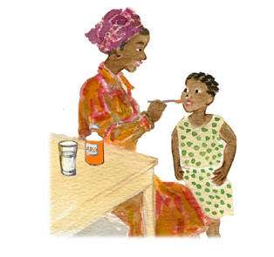
Thank you!
Questions?
Add facilitators contact details here
Notes:
The facilitator, please include your contact details on this slide in case participants need to contact you.

